Slide 1

ROADWAY PROJECT
UPDATES
September 2022

Slide 2
CITY BOND PROJECTS
2018 STREET BOND
$85 Million over 10 years
Taxes are not increasing for Bond

Slide 3


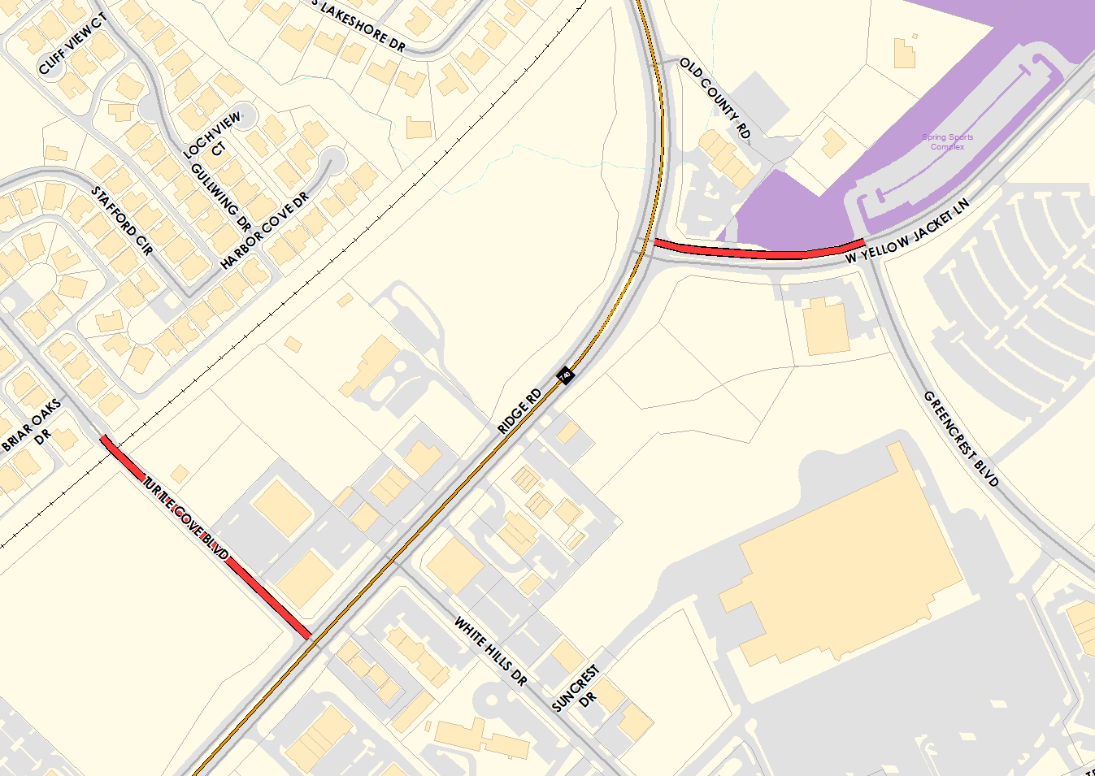

(Briar Oaks Dr. to Ridge Rd.)
(Ridge Rd. to Greencrest Blvd.)
Finalizing Construction
Existing/Proposed: - Turtle Cove: 36’ wide concrete roadway
- W Yellow Jacket: 24’ wide concrete WB lanes

Slide 4

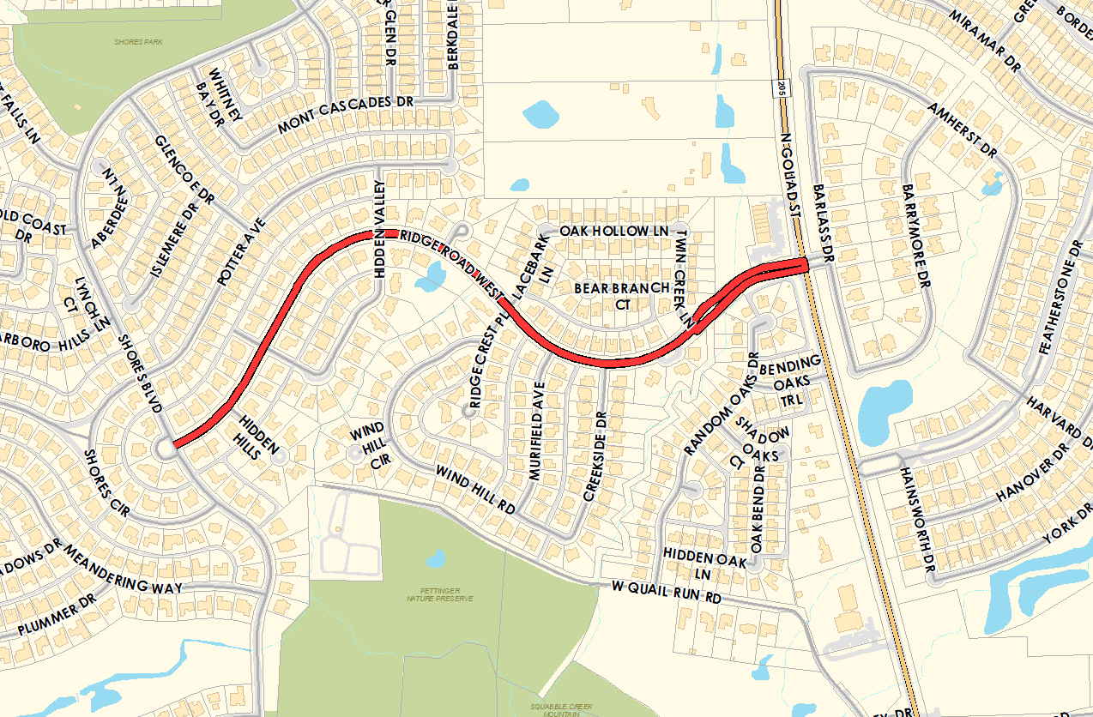
(Shores Blvd to N. Goliad St.)
Finalizing Construction
Existing: - 36’ wide concrete roadway with sidewalk in
various locations
Proposed: - 40’ wide with 6’ sidewalks against curb

Slide 5


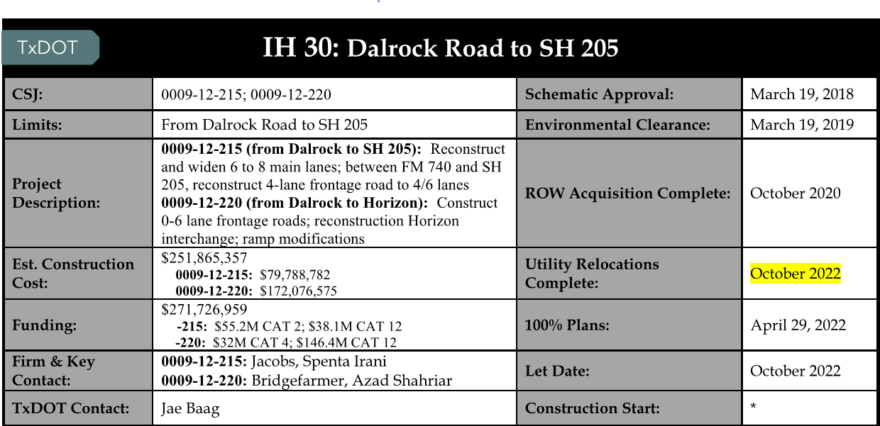
Rockwall County Roadway
Consortium / TxDOT Projects
Rockwall County Roadway Consortium Monthly Report: https://www.rockwallcountytexas.com/279/Road-Consortium

Slide 6
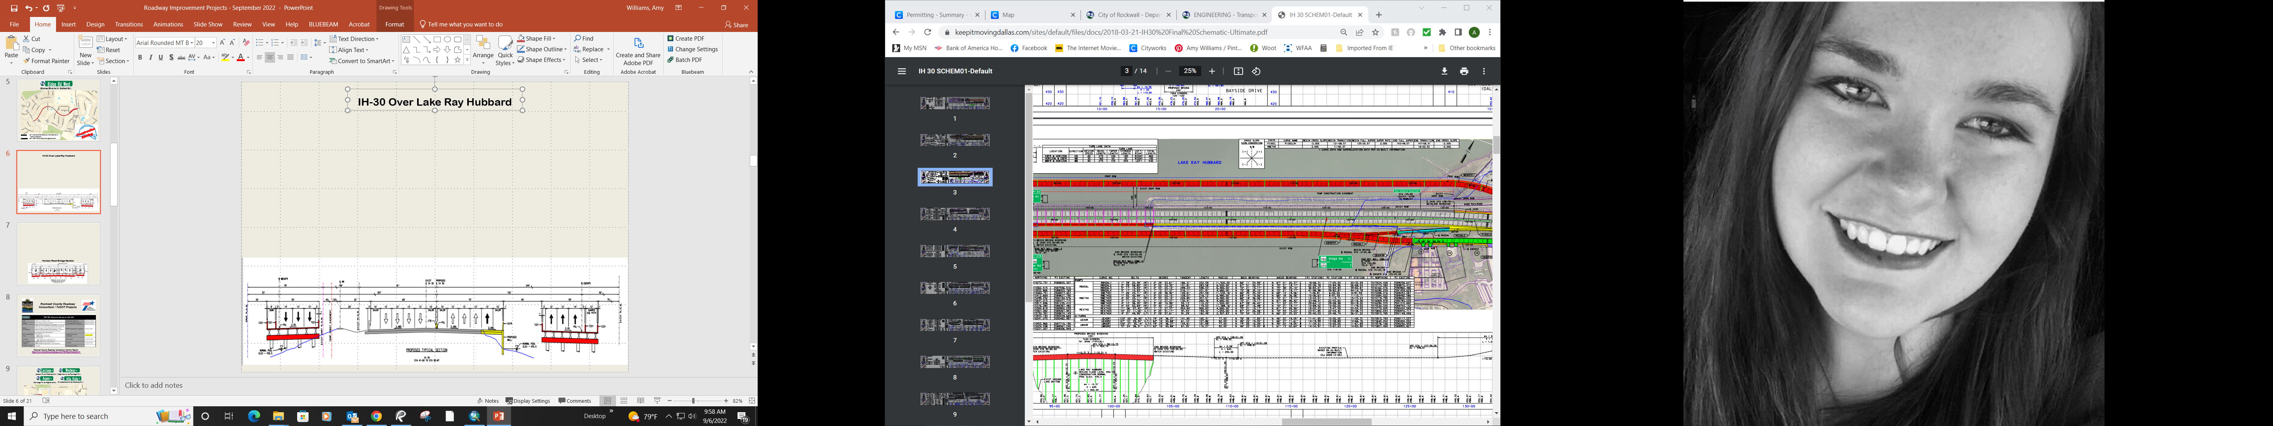
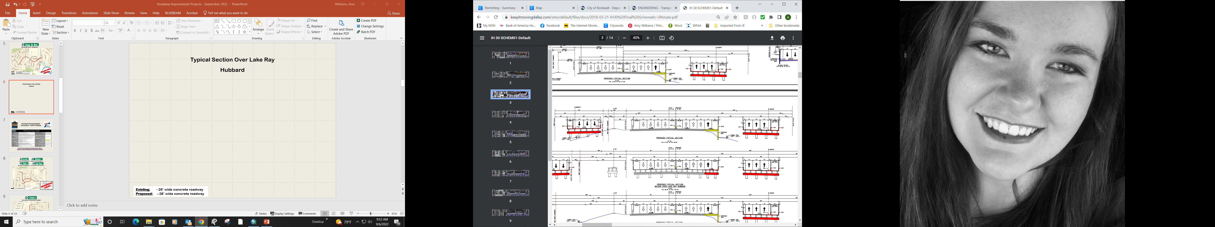
IH-30 Over Lake Ray Hubbard West of Horizon Road
Proposed Roadway Section

Slide 7
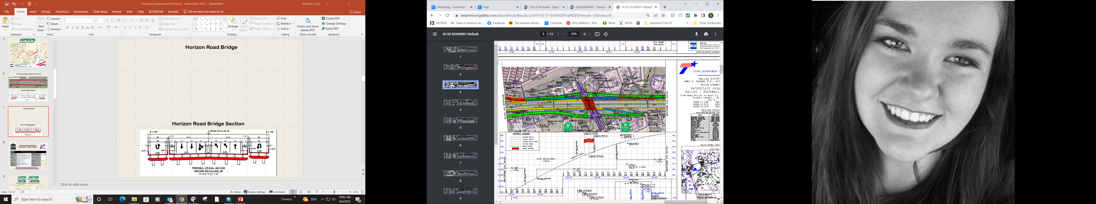

Horizon Road Bridge
Horizon Road Bridge Section

Slide 8
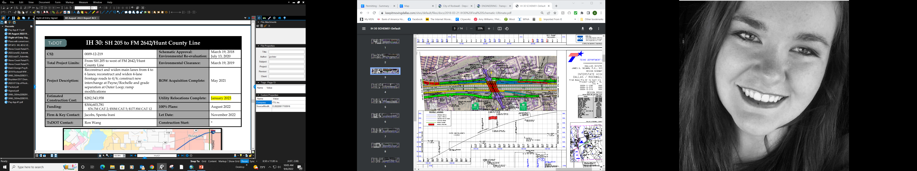
Rockwall County Roadway
Consortium / TxDOT Projects
Rockwall County Roadway Consortium Monthly Report: https://www.rockwallcountytexas.com/279/Road-Consortium

Slide 9
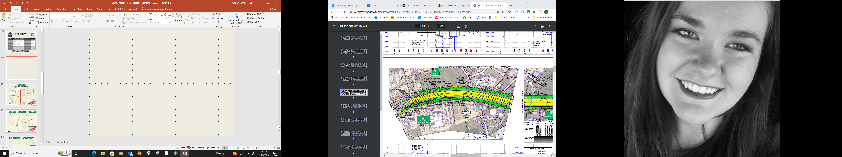
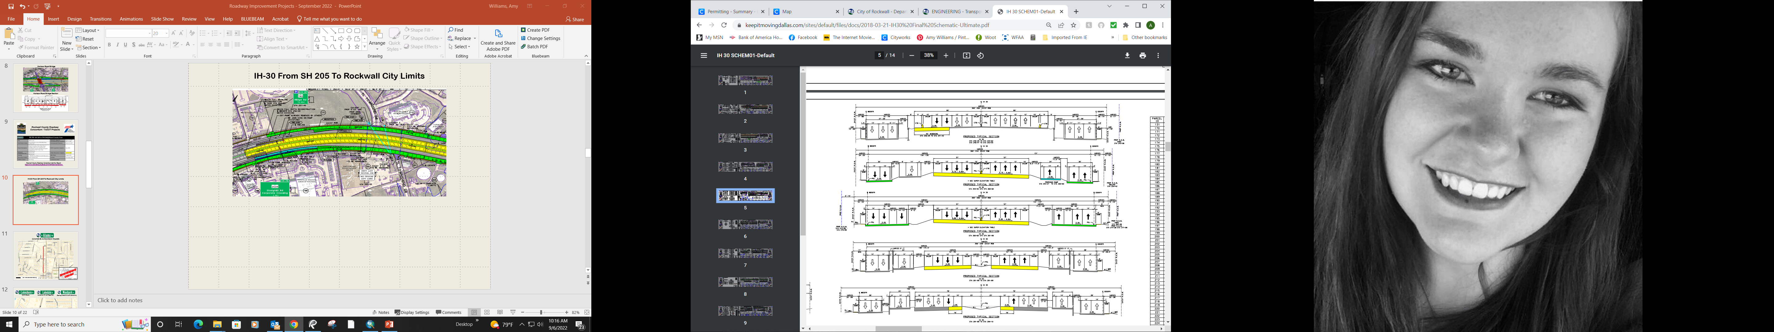
IH-30 From SH 205 To Rockwall City Limits
Proposed Section

Slide 10
Future Rockwall County Roadway
Consortium / TxDOT Projects
Roadways within the Rockwall City Limits
SH 205 South (John King to Kaufman County Line) – Existing 2-lane being constructing 4-lane divided roadway with allowance for an ultimate 6-lane divided roadway
FM 3549 (SH 66 to FM 552) – Existing 2-lane roadway being constructed to a 4-lane divided roadway
FM 549 (SH 276 to FM 740) – Existing 2-lane roadway being constructed to a 4-lane divided roadway
SH 205 (Downtown to John King) – Existing 2-lane roadway being constructed to 4-lane divided/undivided roadway
FM 552 (SH 205 to SH 66) – Existing 2-lane roadway being constructed to a 4-lane divided roadway
Horizon Road/Village Drive – Existing 2-lane and 4-lane roadway being constructed to a 4-lane divided roadway & reconstructing the Village Dr. bridge
FM 3097/Horizon Road (Tubbs Road to FM 549) – Existing 2-lane roadway being constructed to a 4-lane roadway
SH 205 (Ralph Hall Prkwy. to John King Blvd.) – Existing 2-lane roadway being constructed to a 6-lane divided roadway

Slide 11
CAPITAL IMPROVEMENT
PROJECTS (CIP)
WEBSITE
https://sites.google.com/view/rockwallengineering/home

Slide 12
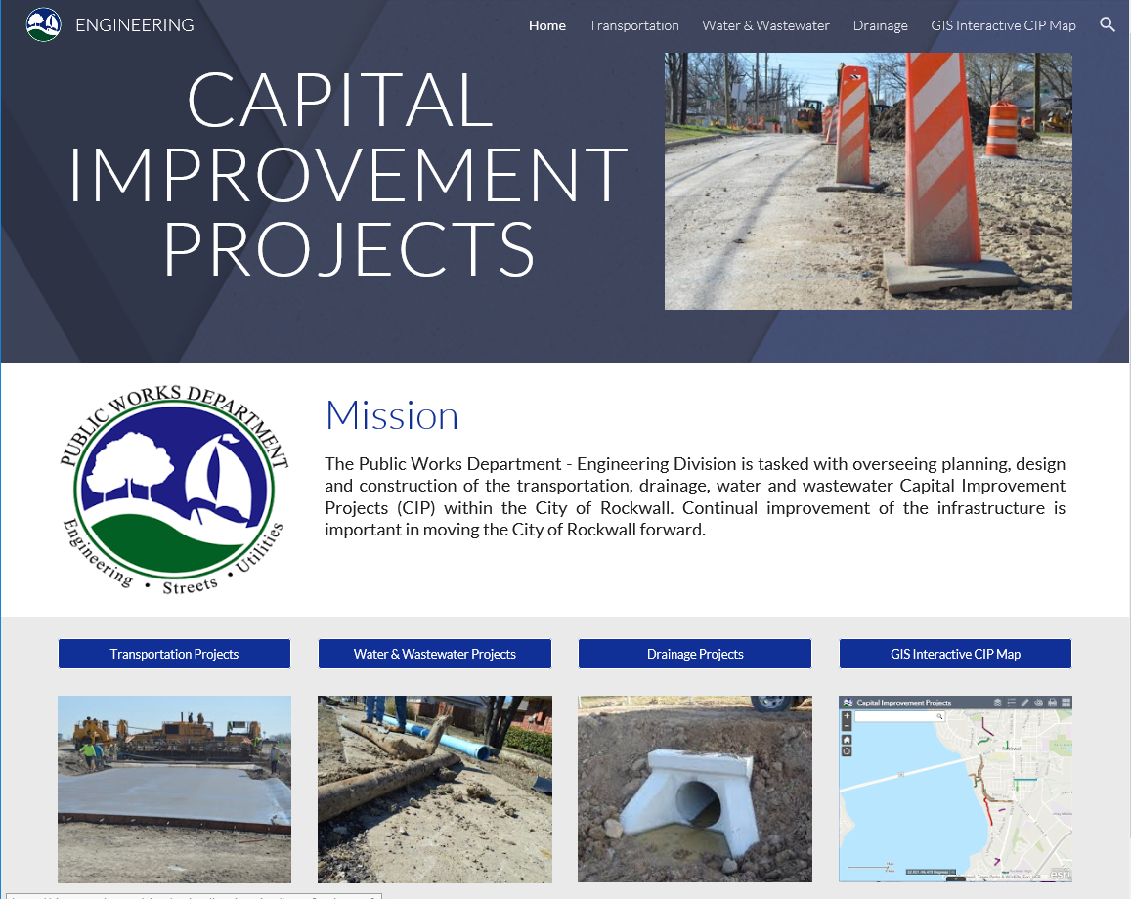

Slide 13
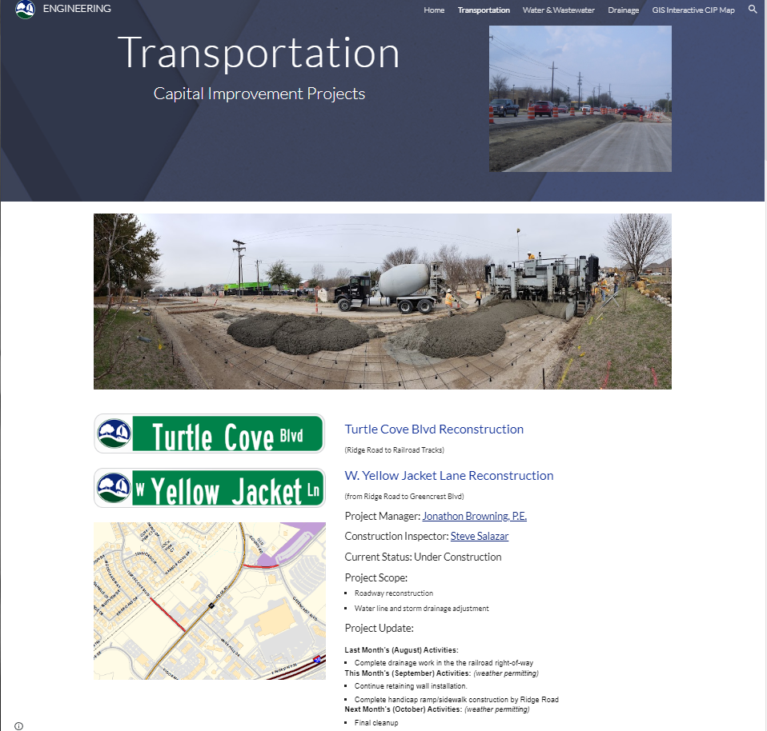

Slide 14
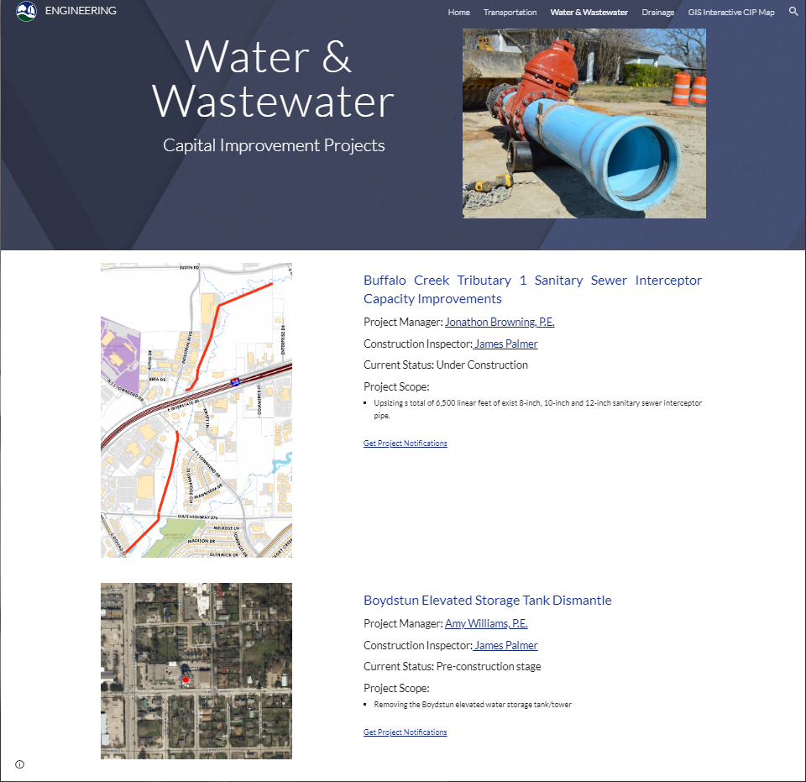

Slide 15
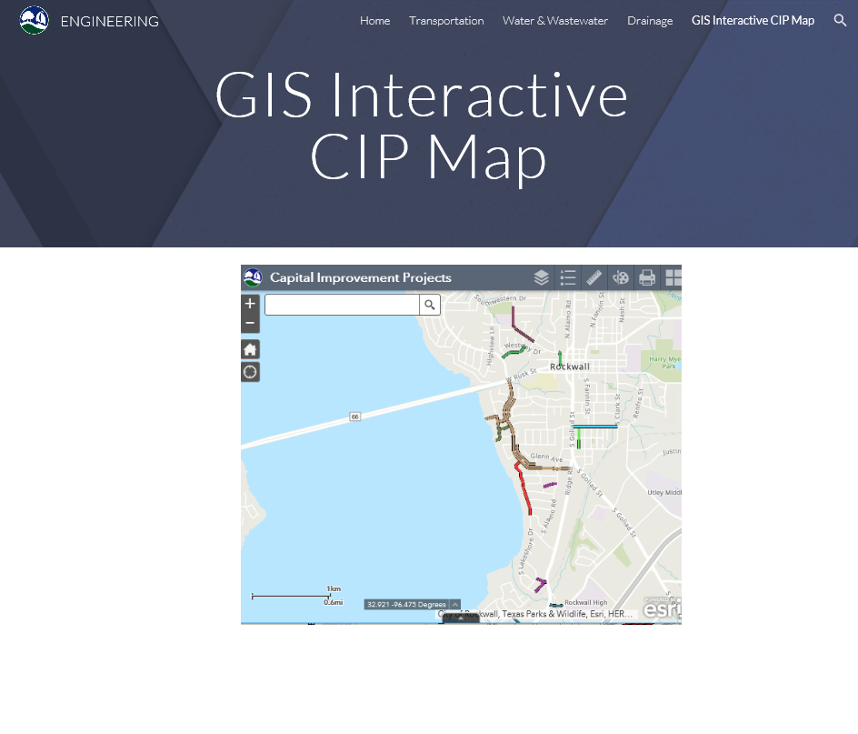
https://rockwall.maps.arcgis.com/apps/webappviewer/index.html?id=58ca8e16ad23456db3124132408175fd

Slide 16
City of Rockwall
Floodplain Management
September 2022

Slide 17

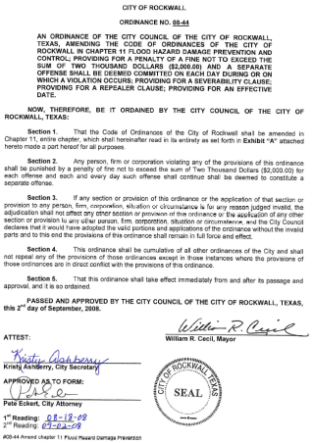


Floodplain Management
Purpose: Promote the public health, safety and welfare and to minimize public and private losses due to flood conditions
City of Rockwall participates in FEMA’s National Flood Insurance Program (NFIP)
City has adopted a Flood Hazard Damage Prevention and Control Ordinance
What’s my Flood Risk?

Slide 18
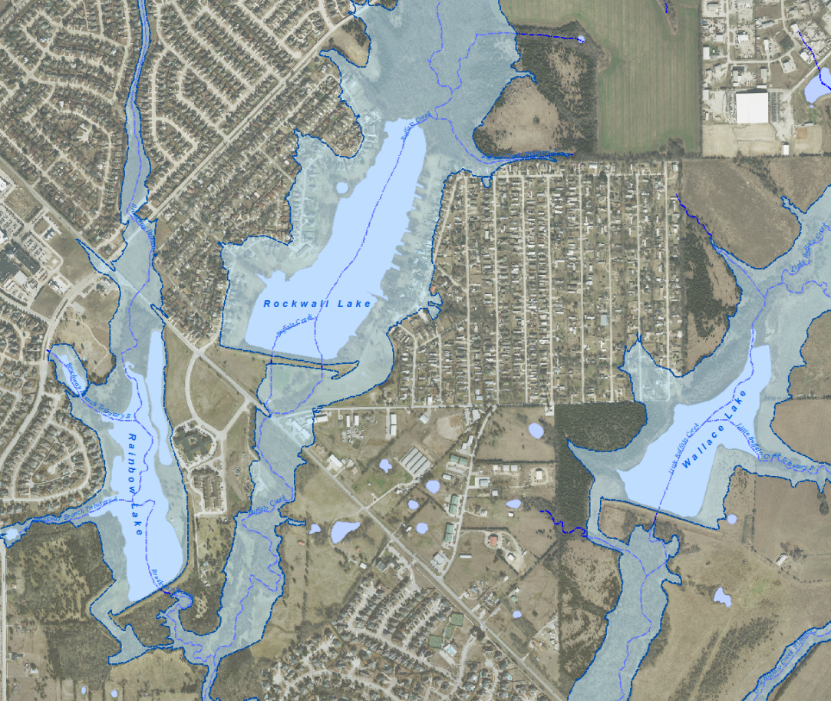
Floodplain Management
Requirements:
Design to 100-Year Fully Developed Watershed Conditions
All structures must have a Finish Floor 2 feet above 100-Year water surface elevation.
NO Fences in Floodplain
NO Fill in Floodplain areas, unless a flood study is approved with no adverse impacts to adjacent properties
Any Substantial Improvement to existing structure must meet current ordinance

