Slide 1
RESIDENTIAL DEVELOPMENT
REALTOR WORKSHOP | SEPTEMBER 14, 2022
PLANNING AND ZONING DEPARTMENT | ROCKWALL TEXAS

Slide 2
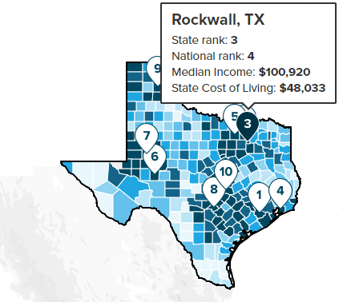


COMMUNITY PROFILE 2022 | RESIDENTIAL DEVELOPMENT
SOURCES:
(1) NORTH CENTRAL TEXAS COUNCIL OF GOVERNMENTS
(2) ESRI BUSINESS ANALYST
(3) TEXAS EDUCATION AGENCY
(4) ROCKWALL GIS DIVISION
(5) US CENSUS BUREAU
POPULATION: 49,300 ⁽¹⁾
MEDIAN INCOME: $106,199 ⁽²⁾
PER CAPITA INCOME: $50,449 ⁽²⁾
POPULATION BY GENDER: ⁽²⁾
  MALE: 48.91%
  FEMALE: 51.08%
POPULATION UNDER 65: 81% (DOWN 7% OVER 2020) ⁽²⁾
POPULATION UNDER 18: 23.1% (DOWN 3.2% OVER 2020) ⁽²⁾
AVERAGE TRAVEL TIME TO WORK: 30.6-MINUTES ⁽²⁾
GRADUATION RATE FOR RISD: 98.20% ⁽³⁾
BACHELORS DEGREE OR HIGHER (25+): 47.1% ⁽²⁾
HOUSING UNITS: 18,903 ⁽²⁾
  OWNER OCCUPIED: 13,621 (72.06%)
  RENTER OCCUPIED: 3,996 (21.14%)
  VACANT: 1,286 (6.80%)
NUMBER OF BUSINESSES: 2,380 ⁽²⁾
EMPLOYEES: 25,799 ⁽²⁾
SOURCE: SMARTASSET; PLACES WITH THE MOST FAVORABLE COST OF LIVING 2021
LAND AREA: 41.78 SQ. MI. ⁽⁴⁾
  CORPORATE LIMITS: 30.09 SQ. MI.
  ETJ: 11.69 SQ. MI.
LAND RATIOS (W/ ETJ): 26,736.65 AC ⁽⁴⁾
  DEVELOPED: 14,560.72-AC (54.46%)
  UNDEVELOPED: 9,436.65-AC (35.29%)
  RIGHT-OF-WAY: 2,739.28-(10.25%)
AGE BY COHORT (2020) (5)

Slide 3
RESIDENTIAL BUILDING PERMITS | RESIDENTIAL DEVELOPMENT
$84.39M
$87.47M
$80.3M
$66M
$81.46M
$36.67M*
BUILDING PERMITS & VALUES | 2008-2022
* NO DATA COLLECTED FROM JUNE 3, 2019 DUE TO HB852
RESIDENTIAL PERMITTING TRENDS
POOL PERMITS 2018-2022: 979 PERMITS ISSUED
SOLAR PERMITS: 2020 = 28; 2021 = 58; 2022 = 83; TOTAL = 169 PERMITS
AVERAGE VALUE OF A RESIDENTIAL REMODEL PERMIT
RESIDENTIAL BUILDING PERMITS
TOTAL VACANT LOTS:
ENTITLED: 1,163
NEW SUBDIVISIONS: 566
EXISTING SUBDIVSIONS: 364
AVERAGE PERMITS PER YEAR: 337
VACANT LOTS TO AVERAGE PERMIT RATIO: ~2.75 YEARS

Slide 4







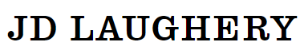

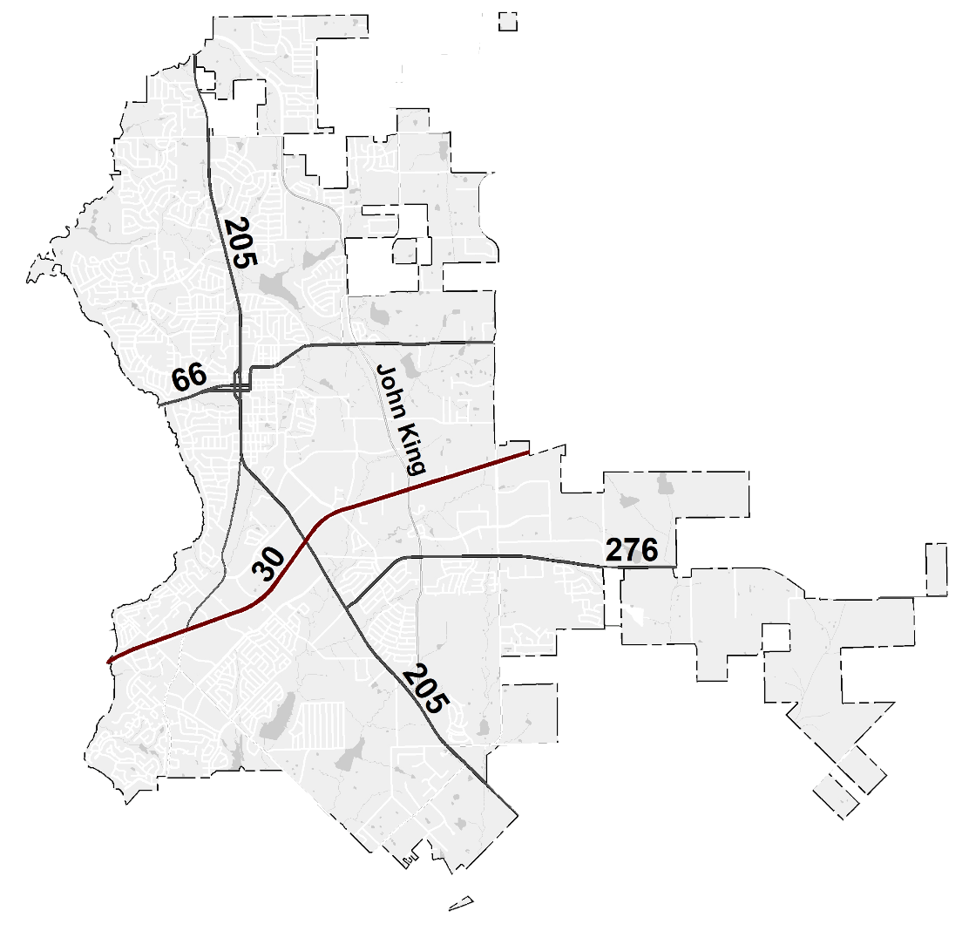


EXISTING SUBDIVSIONS | RESIDENTIAL DEVELOPMENT
PARK PLACE, PHASE 3
VACANT LOTS: 42
THE STANDARD
VACANT LOTS: 33
BREEZY HILL, PHASE 11
VACANT LOTS: 26
WHISPER ROCK
VACANT LOTS: 11
STONE CREEK, PHASE 10
VACANT LOTS: 12
NORTHGATE
VACANT LOTS: 19
TERRACINA, PHASE 1
VACANT LOTS: 110
GIDEON GROVE, PHASE 2
VACANT LOTS: 77
SADDLE STAR, PHASE 1
VACANT LOTS: 7

Slide 5
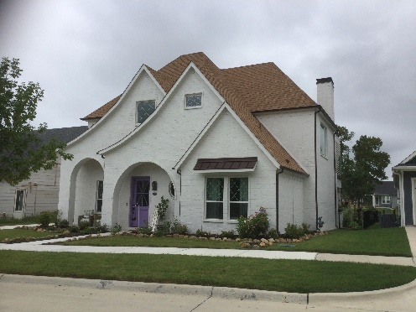
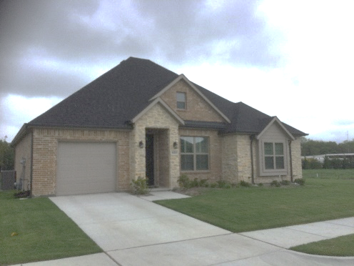
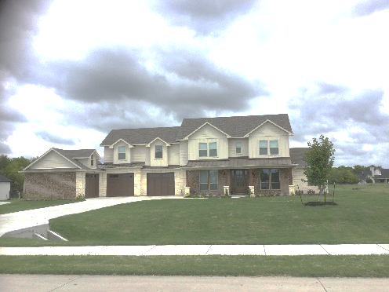
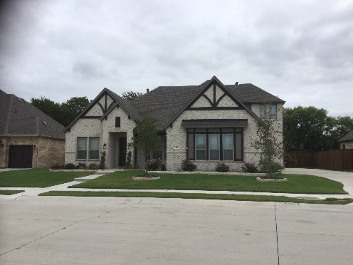
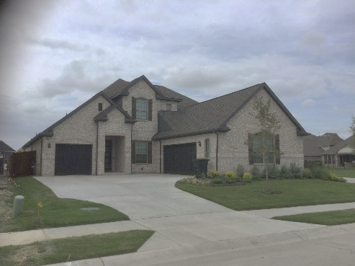
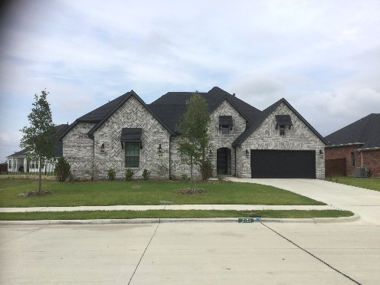
EXISTING SUBDIVSIONS | RESIDENTIAL DEVELOPMENT
PARK PLACE, PHASE 3
VACANT LOTS: 42
THE STANDARD
VACANT LOTS: 33
BREEZY HILL, PHASE 11
VACANT LOTS: 26
WHISPER ROCK
VACANT LOTS: 11
STONE CREEK, PHASE 10
VACANT LOTS: 12
NORTHGATE
VACANT LOTS: 19
TERRACINA, PHASE 1
VACANT LOTS: 110
GIDEON GROVE, PHASE 2
VACANT LOTS: 77
SADDLE STAR, PHASE 1
VACANT LOTS: 7

Slide 6
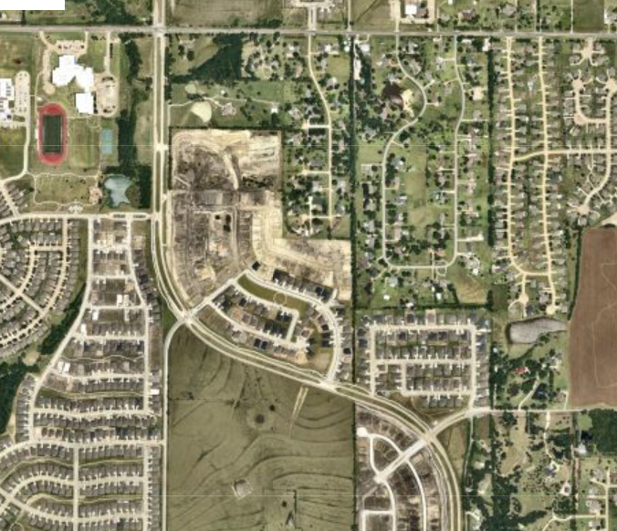
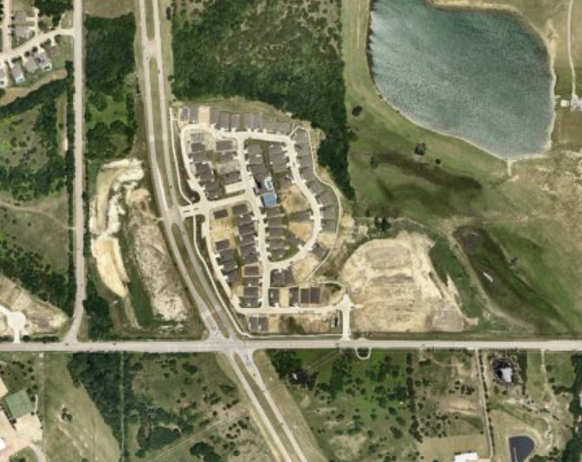
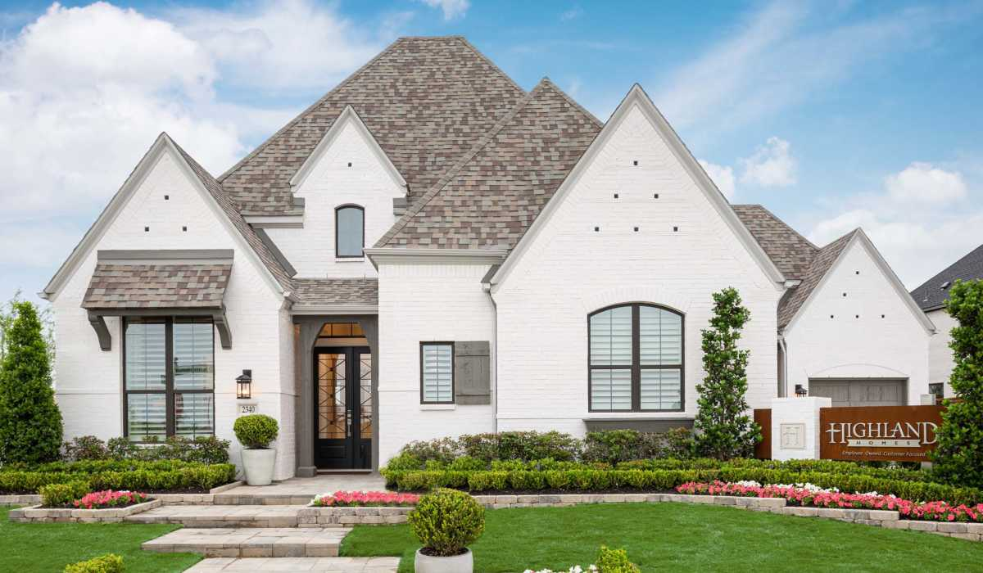
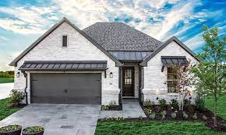
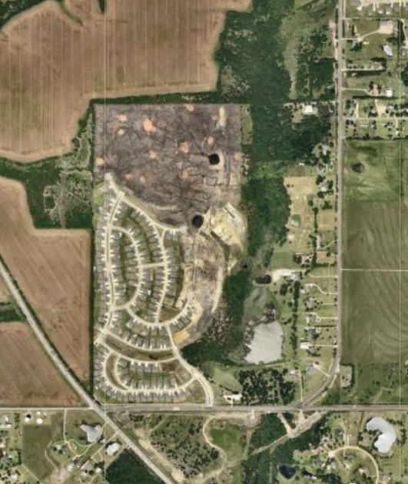
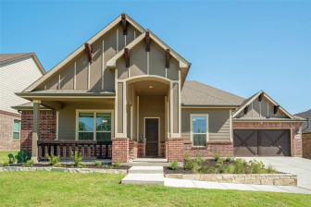
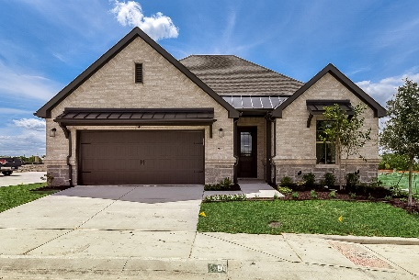
EXISTING SUBDIVSIONS | RESIDENTIAL DEVELOPMENT
SADDLE STAR, PHASE 2
VACANT LOTS: 77
SOMERSET PARK, PHASE 2
VACANT LOTS: 165
LADERA, PHASE 2
VACANT LOTS: 31

Slide 7
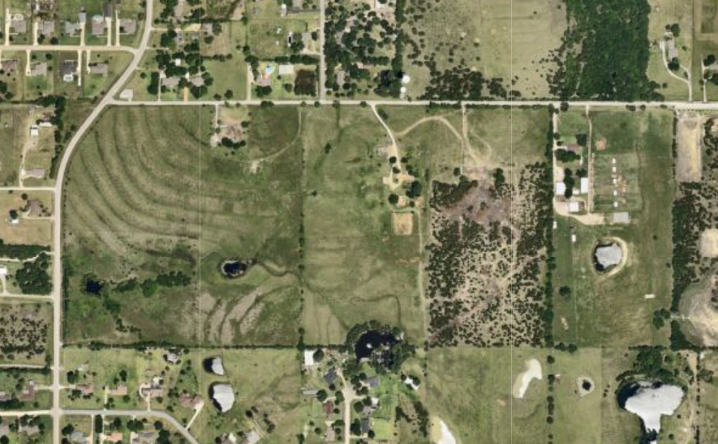
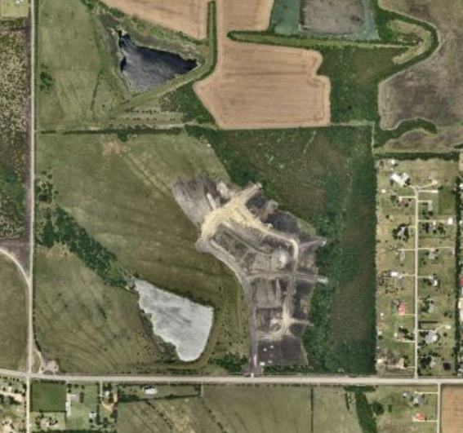
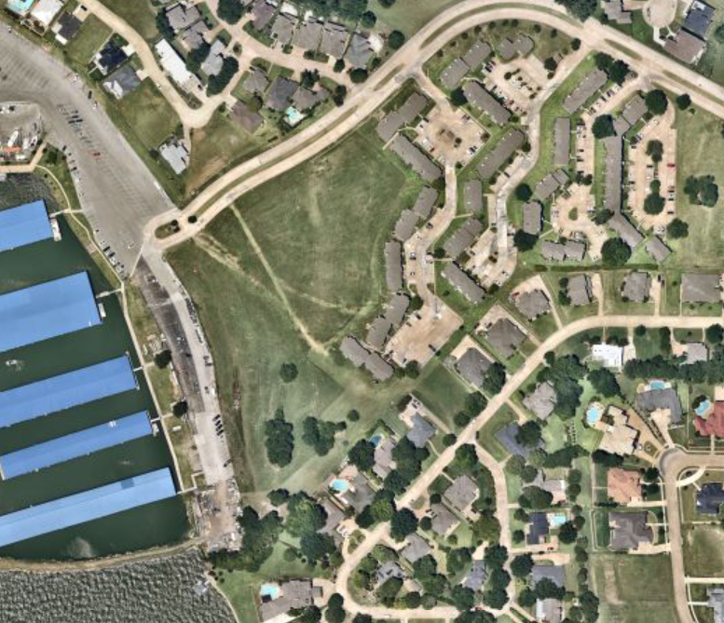
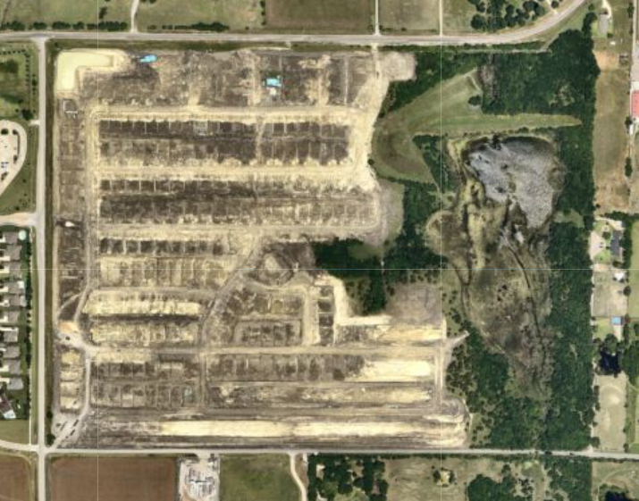
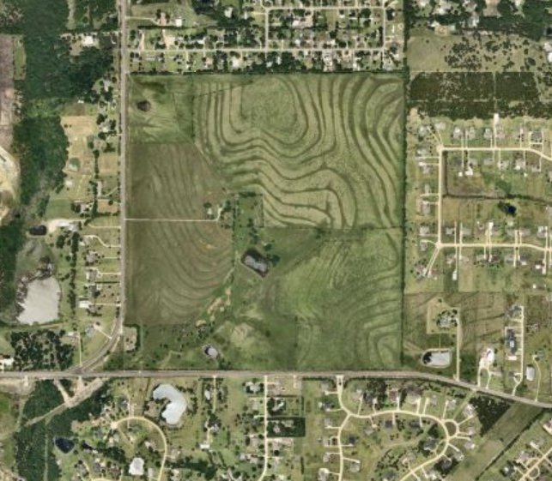
NEW SUBDIVSIONS | RESIDENTIAL DEVELOPMENT
DISCOVERY LAKES
LOTS: 428
PHASE 1 LOTS: 42
LOT SIZES: 6,600 SF – 32,670 SF
OPEN SPACE: 53.26%
AMENITY CENTER: YES
PUBLIC PARK: YES
NELSON LAKE
LOTS: 260
LOT SIZES: 7,000 SF – 8,600 SF
OPEN SPACE: 28.04%
AMENITY CENTER: YES
WINDING CREEK
LOTS: 132
LOT SIZES: 16,000 SF
OPEN SPACE: 20.20%
HOMESTEAD
LOTS: 490
PHASE 1 LOTS: 258
LOT SIZES: 7,440 SF – 12,000 SF
OPEN SPACE: 33.67%
AMENITY CENTER: YES
PUBLIC PARK: YES
MARINA VILLAGE
LOTS: 36 (TOWNHOMES)
LOT SIZES: 3,000 SF
OPEN SPACE: 37.97%

Slide 8
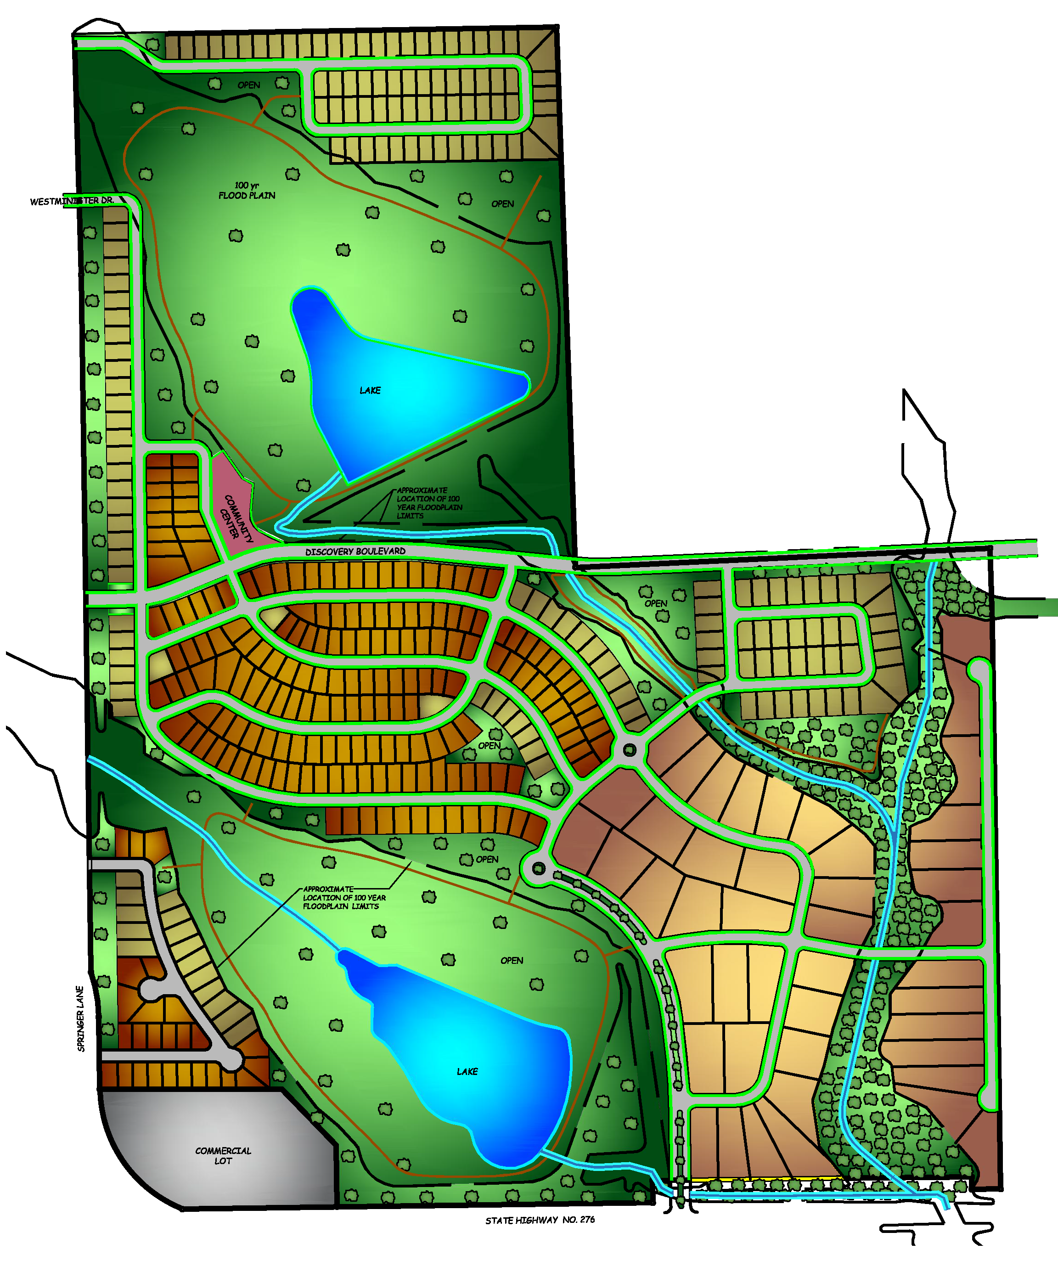
NEW SUBDIVSIONS | RESIDENTIAL DEVELOPMENT
DISCOVERY LAKES
LOTS: 428
PHASE 1 LOTS: 42
LOT SIZES: 6,600 SF – 32,670 SF
OPEN SPACE: 53.26%
AMENITY CENTER: YES
PUBLIC PARK: YES
NELSON LAKE
LOTS: 260
LOT SIZES: 7,000 SF – 8,600 SF
OPEN SPACE: 28.04%
AMENITY CENTER: YES
WINDING CREEK
LOTS: 132
LOT SIZES: 16,000 SF
OPEN SPACE: 20.02%
HOMESTEAD
LOTS: 490
PHASE 1 LOTS: 258
LOT SIZES: 7,440 SF – 12,000 SF
OPEN SPACE: 33.67%
AMENITY CENTER: YES
PUBLIC PARK: YES
MARINA VILLAGE
LOTS: 36 (TOWNHOMES)
LOT SIZES: 3,000 SF
OPEN SPACE: 37.97%

Slide 9
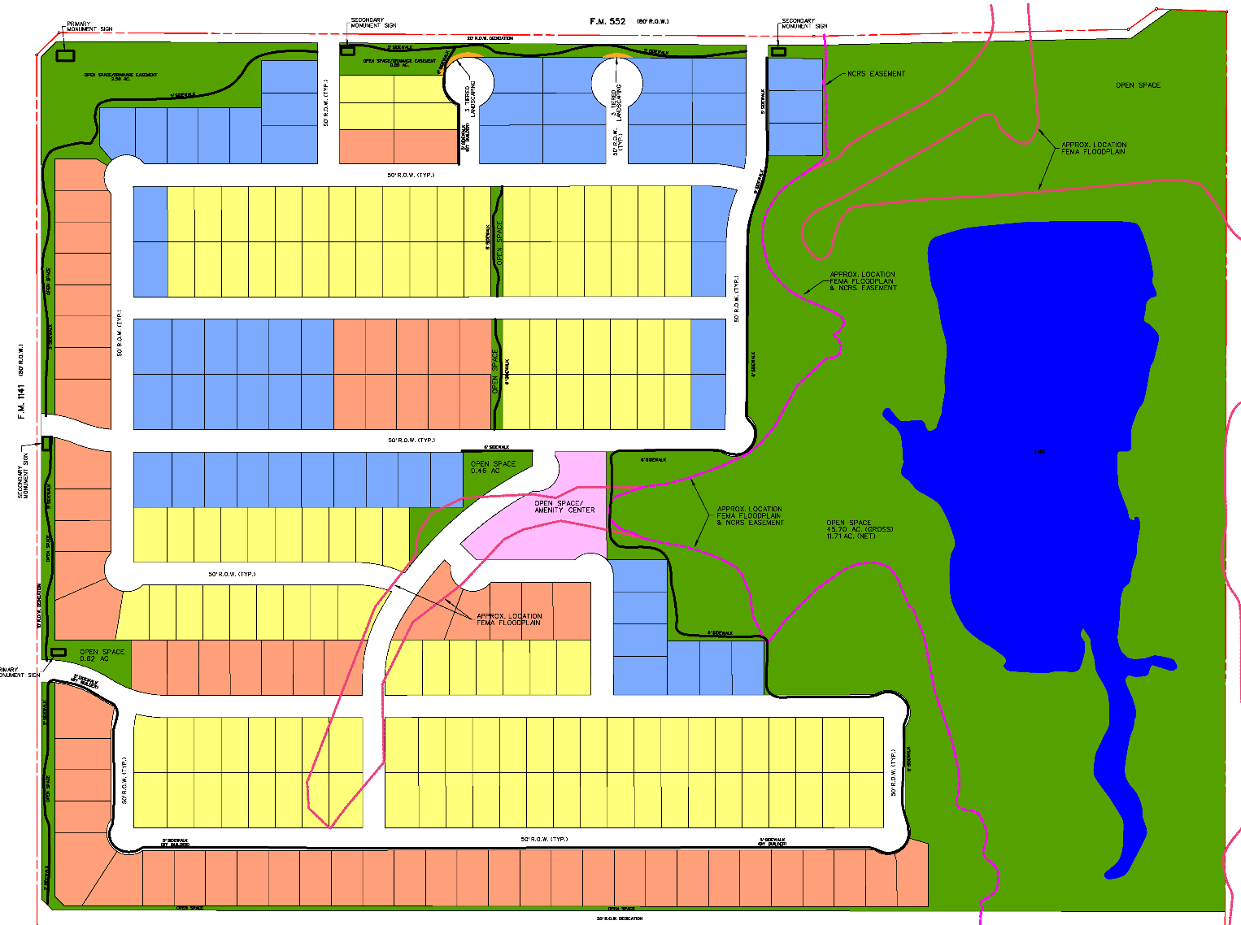
NEW SUBDIVSIONS | RESIDENTIAL DEVELOPMENT
DISCOVERY LAKES
LOTS: 428
PHASE 1 LOTS: 42
LOT SIZES: 6,600 SF – 32,670 SF
OPEN SPACE: 53.26%
AMENITY CENTER: YES
PUBLIC PARK: YES
NELSON LAKE
LOTS: 260
LOT SIZES: 7,000 SF – 8,600 SF
OPEN SPACE: 28.04%
AMENITY CENTER: YES
WINDING CREEK
LOTS: 132
LOT SIZES: 16,000 SF
OPEN SPACE: 20.02%
HOMESTEAD
LOTS: 490
PHASE 1 LOTS: 258
LOT SIZES: 7,440 SF – 12,000 SF
OPEN SPACE: 33.67%
AMENITY CENTER: YES
PUBLIC PARK: YES
MARINA VILLAGE
LOTS: 36 (TOWNHOMES)
LOT SIZES: 3,000 SF
OPEN SPACE: 37.97%

Slide 10
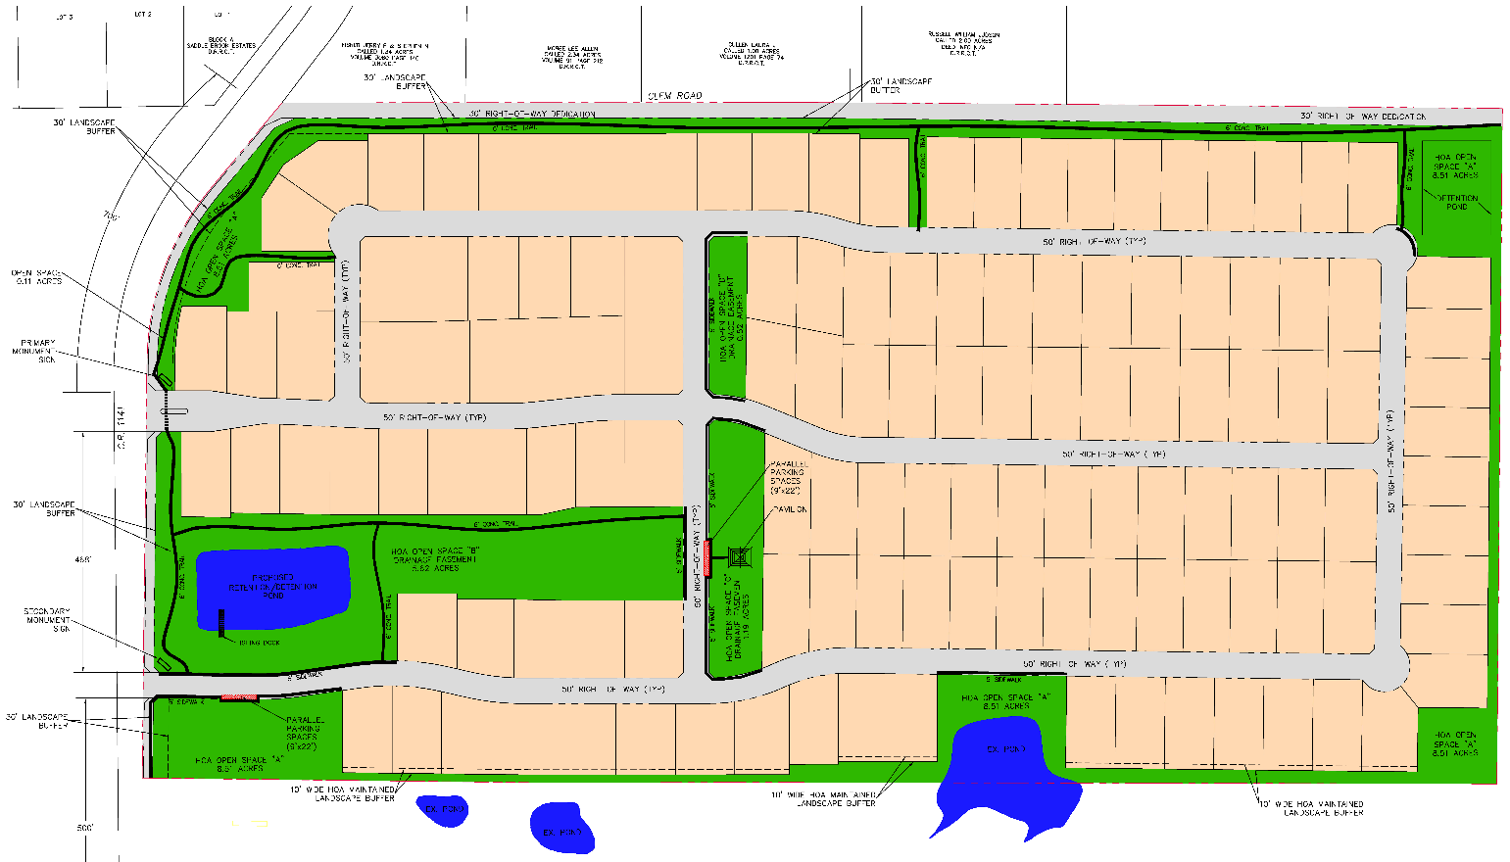
NEW SUBDIVSIONS | RESIDENTIAL DEVELOPMENT
DISCOVERY LAKES
LOTS: 428
PHASE 1 LOTS: 42
LOT SIZES: 6,600 SF – 32,670 SF
OPEN SPACE: 53.26%
AMENITY CENTER: YES
PUBLIC PARK: YES
NELSON LAKE
LOTS: 260
LOT SIZES: 7,000 SF – 8,600 SF
OPEN SPACE: 28.04%
AMENITY CENTER: YES
WINDING CREEK
LOTS: 132
LOT SIZES: 16,000 SF
OPEN SPACE: 20.02%
HOMESTEAD
LOTS: 490
PHASE 1 LOTS: 258
LOT SIZES: 7,440 SF – 12,000 SF
OPEN SPACE: 33.67%
AMENITY CENTER: YES
PUBLIC PARK: YES
MARINA VILLAGE
LOTS: 36 (TOWNHOMES)
LOT SIZES: 3,000 SF
OPEN SPACE: 37.97%

Slide 11
NEW SUBDIVSIONS | RESIDENTIAL DEVELOPMENT
DISCOVERY LAKES
LOTS: 428
PHASE 1 LOTS: 42
LOT SIZES: 6,600 SF – 32,670 SF
OPEN SPACE: 53.26%
AMENITY CENTER: YES
PUBLIC PARK: YES
NELSON LAKE
LOTS: 260
LOT SIZES: 7,000 SF – 8,600 SF
OPEN SPACE: 28.04%
AMENITY CENTER: YES
WINDING CREEK
LOTS: 132
LOT SIZES: 16,000 SF
OPEN SPACE: 20.02%
HOMESTEAD
LOTS: 490
PHASE 1 LOTS: 258
LOT SIZES: 7,440 SF – 12,000 SF
OPEN SPACE: 33.67%
AMENITY CENTER: YES
PUBLIC PARK: YES
MARINA VILLAGE
LOTS: 36 (TOWNHOMES)
LOT SIZES: 3,000 SF
OPEN SPACE: 37.97%

Slide 12
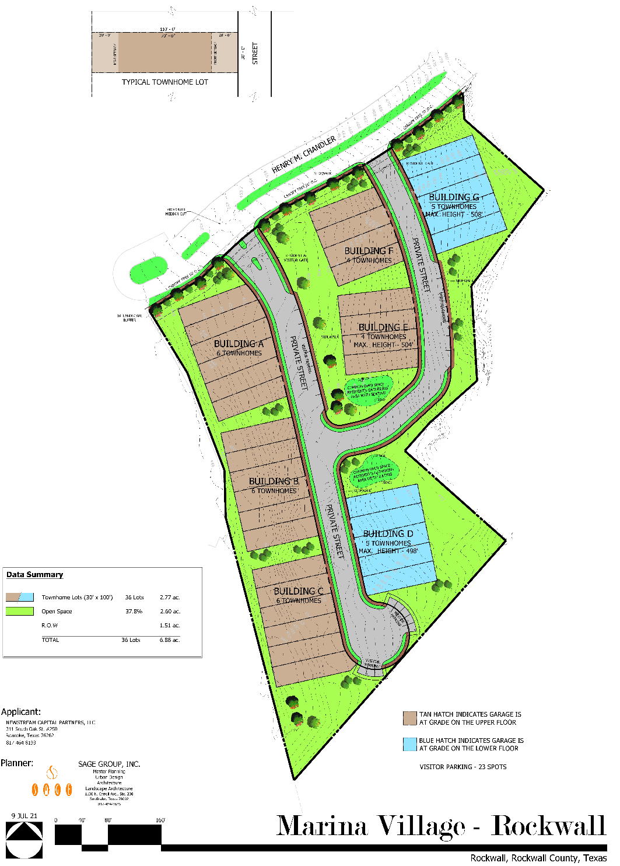
NEW SUBDIVSIONS | RESIDENTIAL DEVELOPMENT
DISCOVERY LAKES
LOTS: 428
PHASE 1 LOTS: 42
LOT SIZES: 6,600 SF – 32,670 SF
OPEN SPACE: 53.26%
AMENITY CENTER: YES
PUBLIC PARK: YES
NELSON LAKE
LOTS: 260
LOT SIZES: 7,000 SF – 8,600 SF
OPEN SPACE: 28.04%
AMENITY CENTER: YES
WINDING CREEK
LOTS: 132
LOT SIZES: 16,000 SF
OPEN SPACE: 20.02%
HOMESTEAD
LOTS: 490
PHASE 1 LOTS: 258
LOT SIZES: 7,440 SF – 12,000 SF
OPEN SPACE: 33.67%
AMENITY CENTER: YES
PUBLIC PARK: YES
MARINA VILLAGE
LOTS: 36 (TOWNHOMES)
LOT SIZES: 3,000 SF
OPEN SPACE: 37.97%

Slide 13
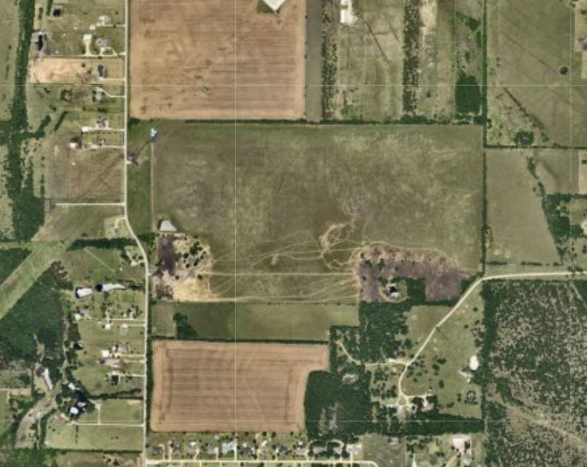
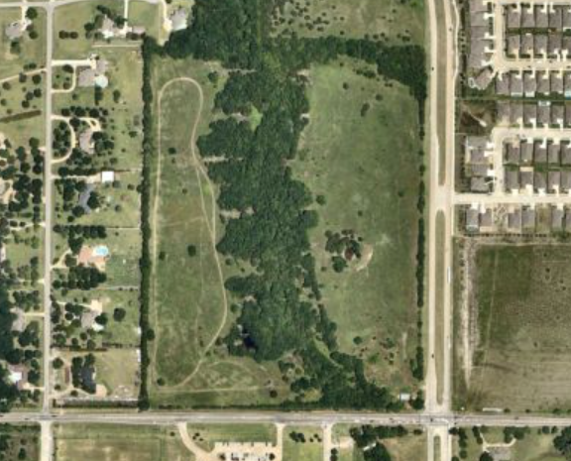
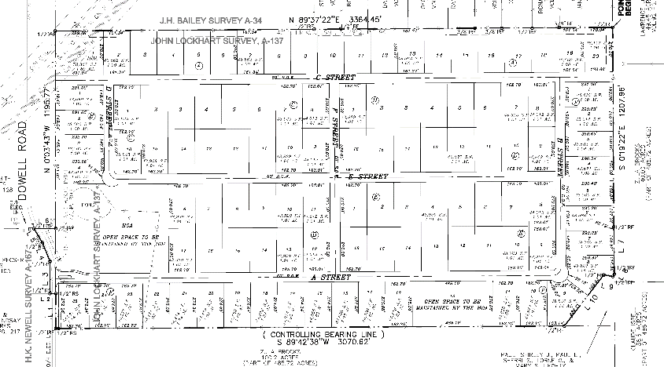
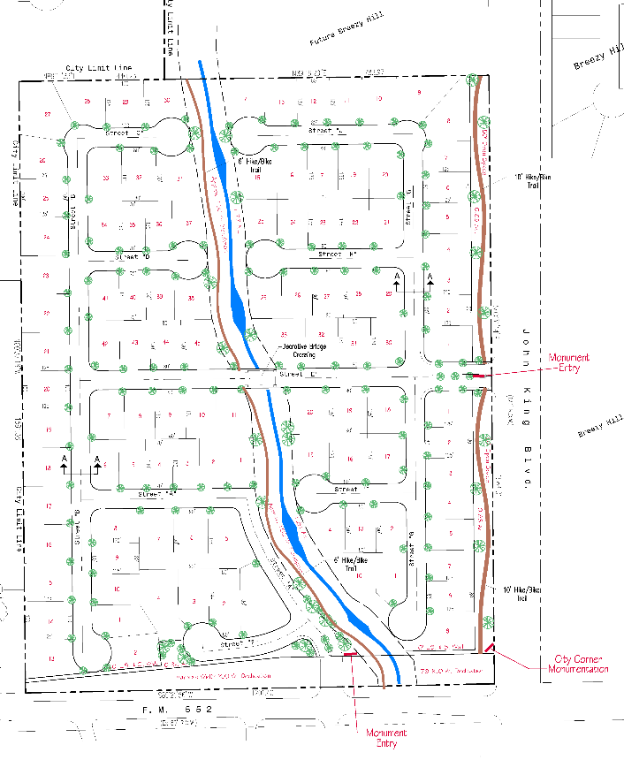
NEW SUBDIVSIONS | RESIDENTIAL DEVELOPMENT
EMERSON FARMS
LOTS: 107
LOT SIZES: 43,560 SF
OPEN SPACE: 20.00%
SADDLE STAR NORTH
LOTS: 109
LOT SIZES: 8,750 SF – 12,500 SF
OPEN SPACE: 12.59%

Slide 14
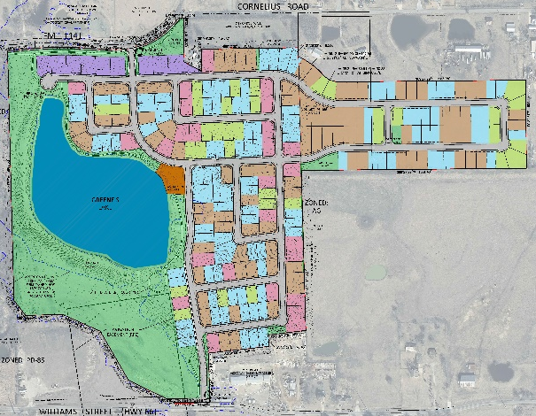
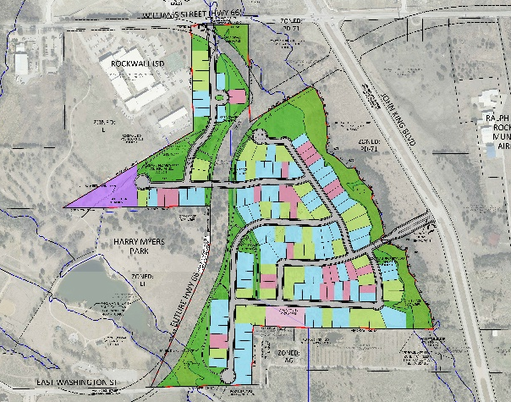
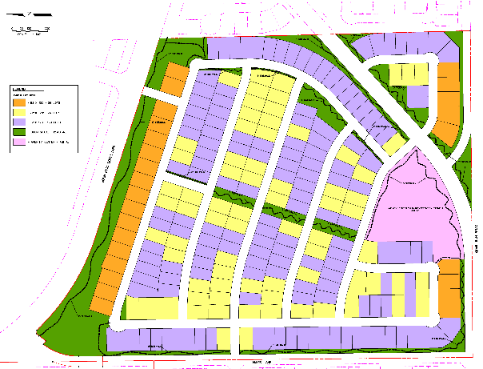
SINGLE FAMILY ZONING CASES | RESIDENTIAL DEVELOPMENT
CITY OF ROCKWALL GROWTH RATE, 2020-2022
PER NORTH CENTRAL TEXAS COUNCIL OF GOVERNMENT (NCTCOG)
THE TERRACES
LOTS: 263
LOT SIZES: 7,200 SF – 13,000 SF
OPEN SPACE: 29.71%
AMENITY CENTER: YES
CITY PARK: YES
YEAR | POPULATION | GROWTH RATE
2020 | 47,251 | X
2021 | 48,010 | 1.61%
2022 | 49,300 | 2.69%
PARK HILLS
LOTS: 144
LOT SIZES: 6,000 SF – 8,400 SF
OPEN SPACE: 27.51%
AMENITY CENTER: YES
CITY PARK: NO
QUAIL HOLLOW
LOTS: 250
LOT SIZES: 7,440 SF – 10,250 SF
OPEN SPACE: 20.12%
AMENITY CENTER: YES
CITY PARK: NO

Slide 15
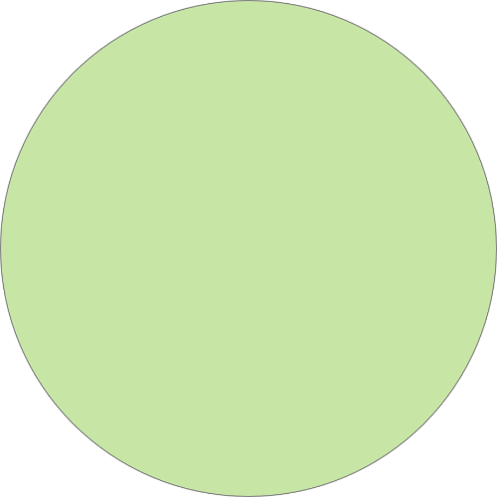
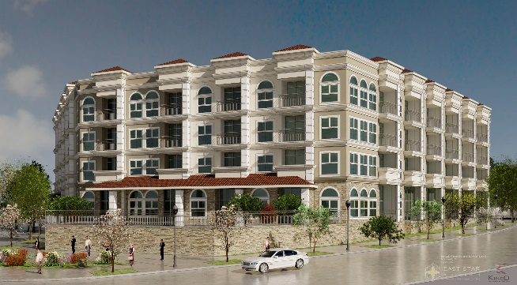
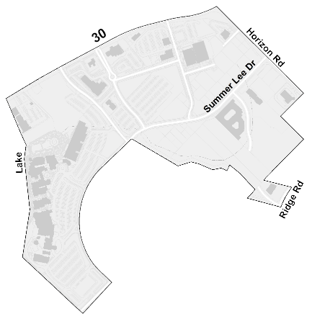
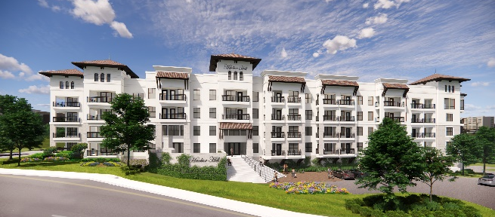
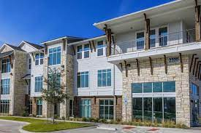
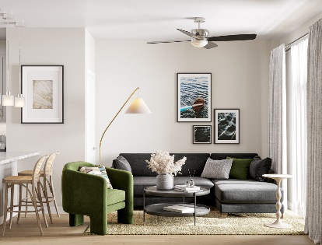
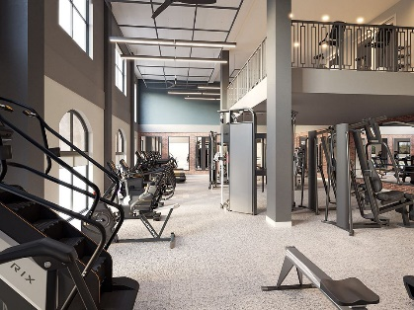
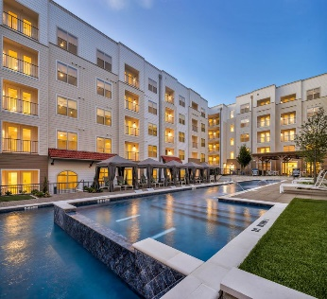
MULTI-FAMILY DEVELOPMENT | RESIDENTIAL DEVELOPMENT
HARBOR VILLAGE CONDOMINIUMS
NUMBER OF UNITS: 375
STATUS: COMPLETE/LEASING
HARBOR HILLS RESIDENCE
NUMBER OF UNITS: 265
STATUS: UNDER CONSTRUCTION
HARBOR RESIDENCES
NUMBER OF UNITS: 176
STATUS: ENTITLED
SUNSET RIDGE RESIDENCES
NUMBER OF UNITS: 42
STATUS: ENTITLED
THE ROYALTON AT ROCKWALL DOWNES
NUMBER OF UNITS: 590
STATUS: UNDER CONSTRUCTION

Slide 16
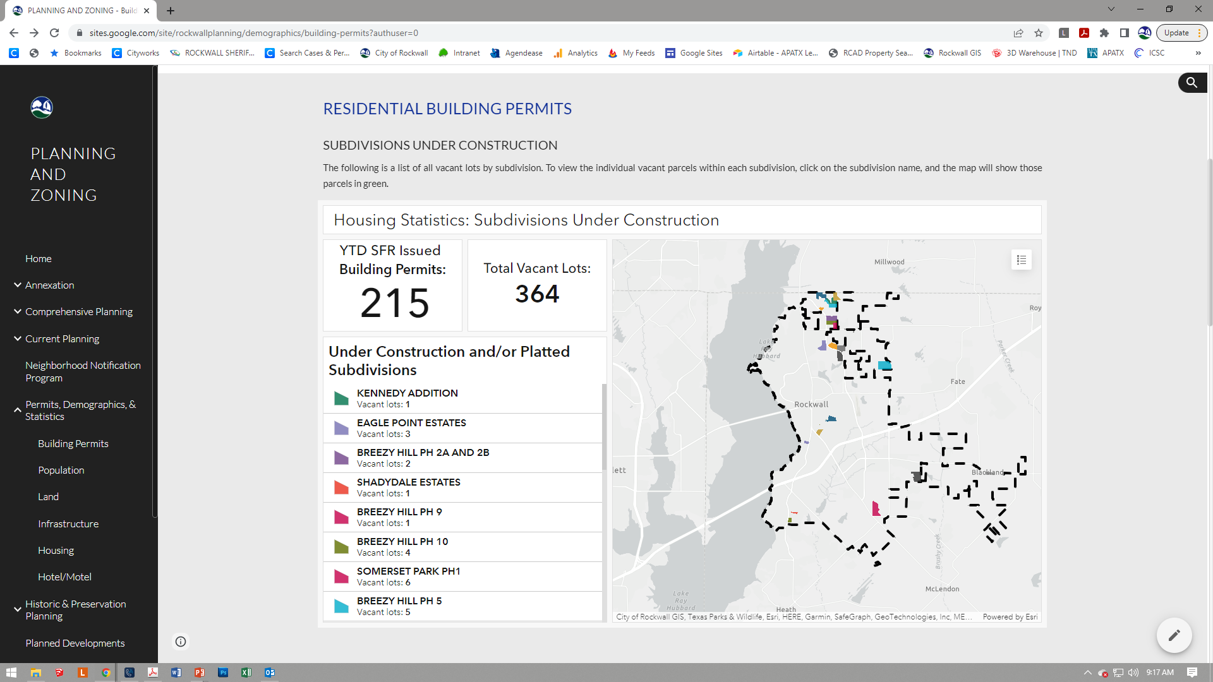
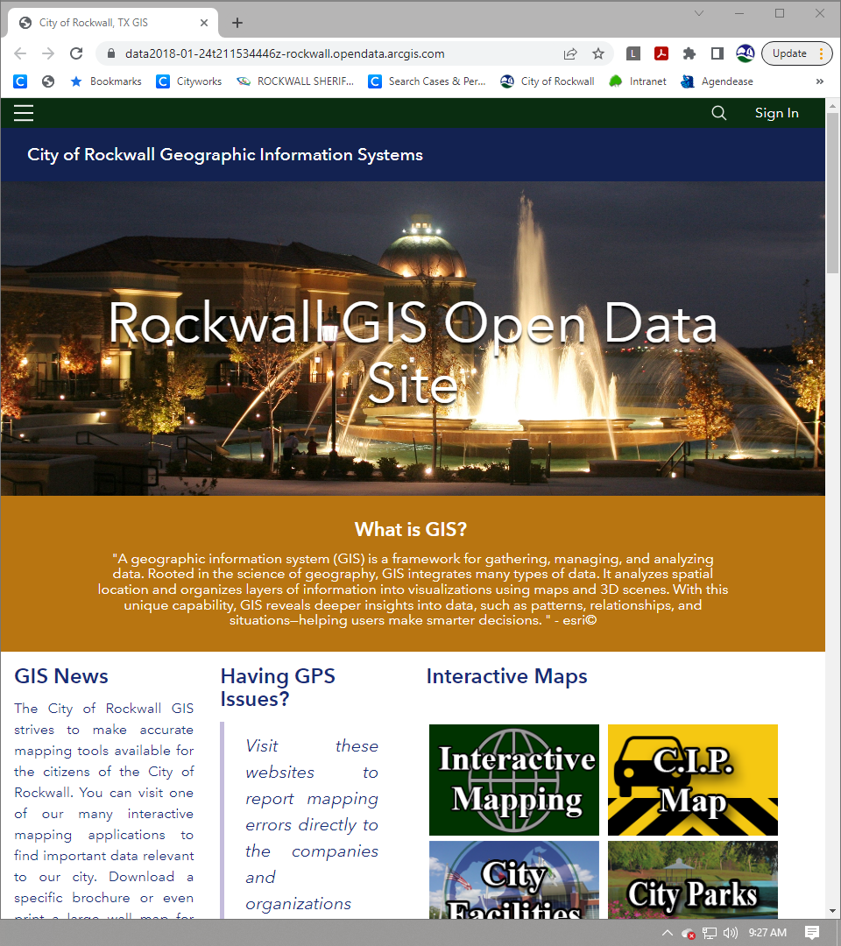

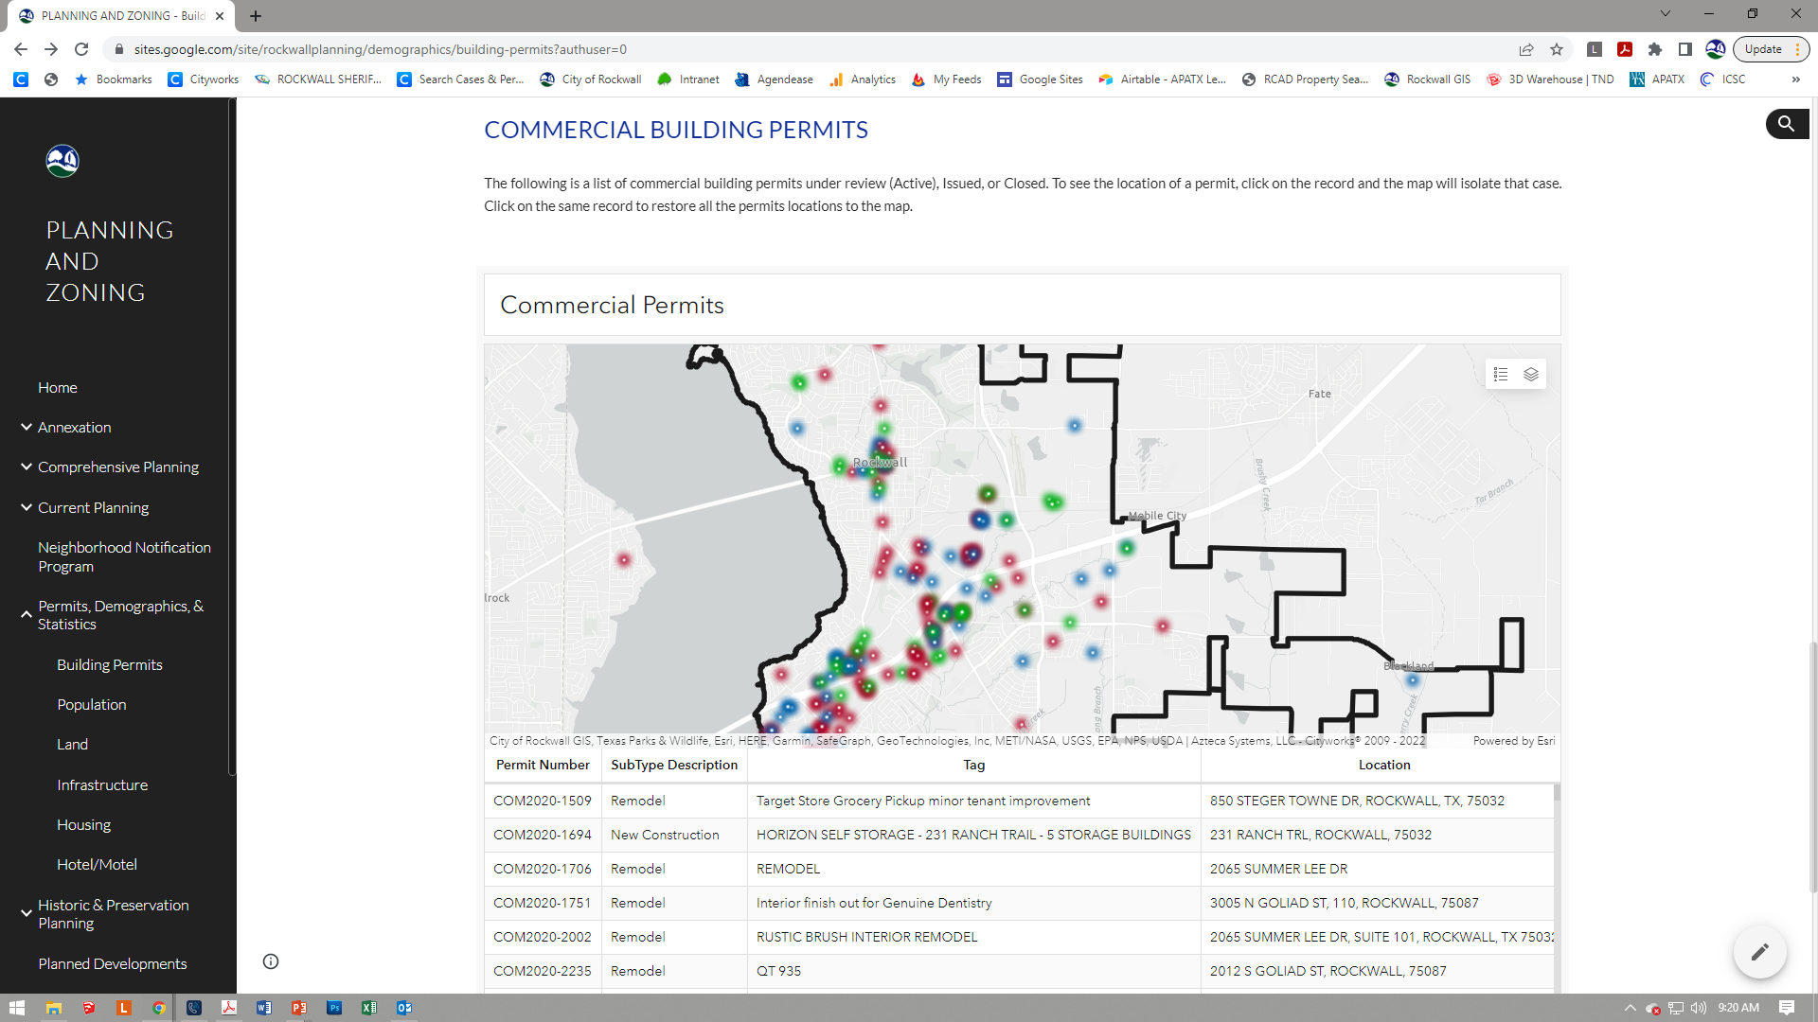
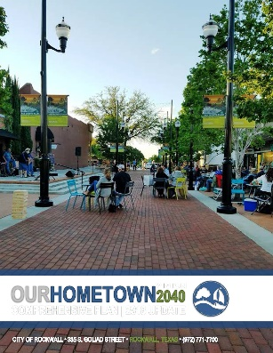
ADDITIONAL ONLINE TOOLS | WWW.ROCKWALL.COM
INFORMATION AVAILABLE ONLINE
ONLINE MAPS
DEMOGRAPHICS
DEVELOPMENT CASES
UTILITY INFORMATION
TAKELINE LEASING INFORMATION
CODES AND LONG RANGE PLANNING DOCUMENTS
SUBDIVSION PLATS
HTTPS://SITES.GOOGLE.COM/SITE/ROCKWALLPLANNING/DEMOGRAPHICS/BUILDING-PERMITS
HTTPS://DATA2018-01-24T211534446Z-ROCKWALL.OPENDATA.ARCGIS.COM/

Slide 17
QUESTIONS?

