Slide 1
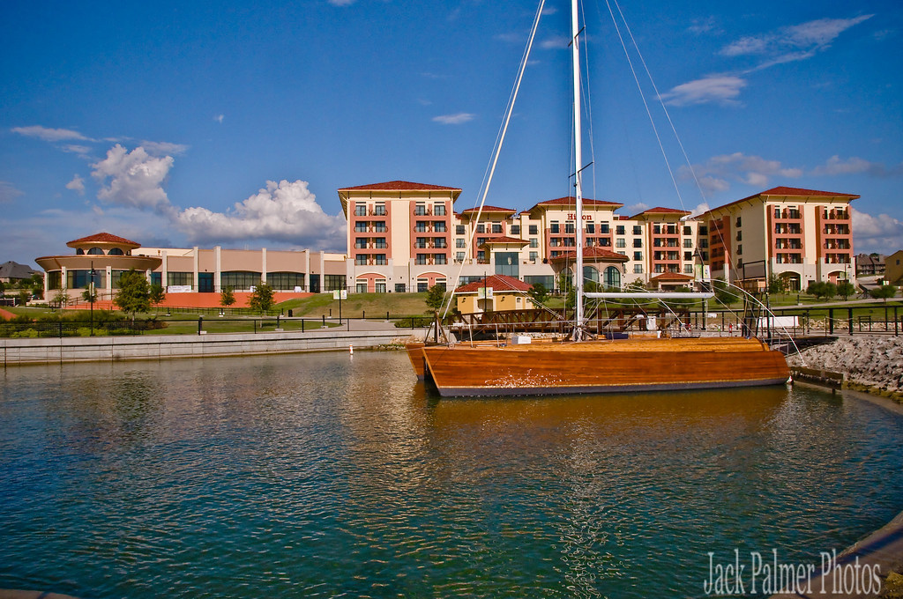



Slide 2

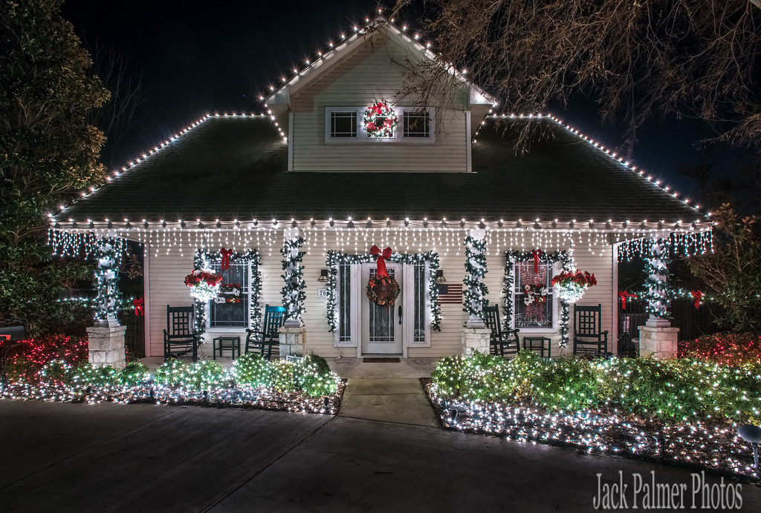
  City/Chamber Partnerships
  Funding
  Who is Visit Rockwall?
  Organizational Profile
  Our Team
  Marketing Initiatives
  Video
  Marketing Strategy
  Future Plans and Goals
  Economic Impact
  Highlights
  Industry Partners
  Branding
  2024 Objectives and Goals
  Visitor Center
  Closing

Slide 3
IF YOU BUILD A PLACE PEOPLE WANT TO VISIT, YOU BUILD A PLACE WHERE PEOPLE WANT TO LIVE.
-MAURA GAST

Slide 4



CITY/CHAMBER PARTNERSHIP

Slide 5


HOTEL OCCUPANCY TAX
State
6%
Total Rate
13%
Local
7%

Slide 6
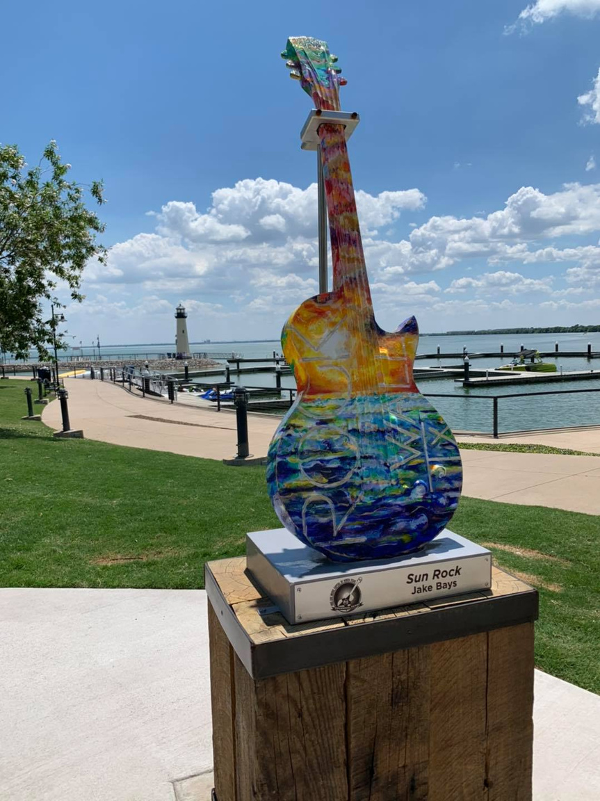
WHO IS VISIT ROCKWALL ?
Visit Rockwall serves as the Destination Marketing Organization for the City of Rockwall, Texas. Our goal is to introduce visitors to the area while highlighting the many things to do. We continue to work diligently to increase tourism to Rockwall.
Our mission is to market everything Rockwall has to offer to attract visitors. Continued collaborations with local organizations all us to serve as an advocate for the city and be a positive voice for the community.
Our goal is to inspire both leisure and business travelers to choose Rockwall as the next destination by highlighting its unique attractions, shopping, dining, history, the great outdoors, and entertainment. Lets not forget why we are known as the Free Live Capitol of North Texas. Visit Rockwall remains committed to helping visitors discover their next adventure in Rockwall.

Slide 7
ORGANIZATIONAL PROFILE
Our Philosophy
To promote Rockwall as a premiere tourist destination.
Our Mission
Our Vision
Our Goals
To improve the quality of life in Rockwall through travel & tourism by marketing Rockwall as an attractive meeting & visitor destination.
To be recognized as the destination for excellence in services, community collaboration, business growth, tourism and quality living.
Bring in visitors to drive our local community.

Slide 8
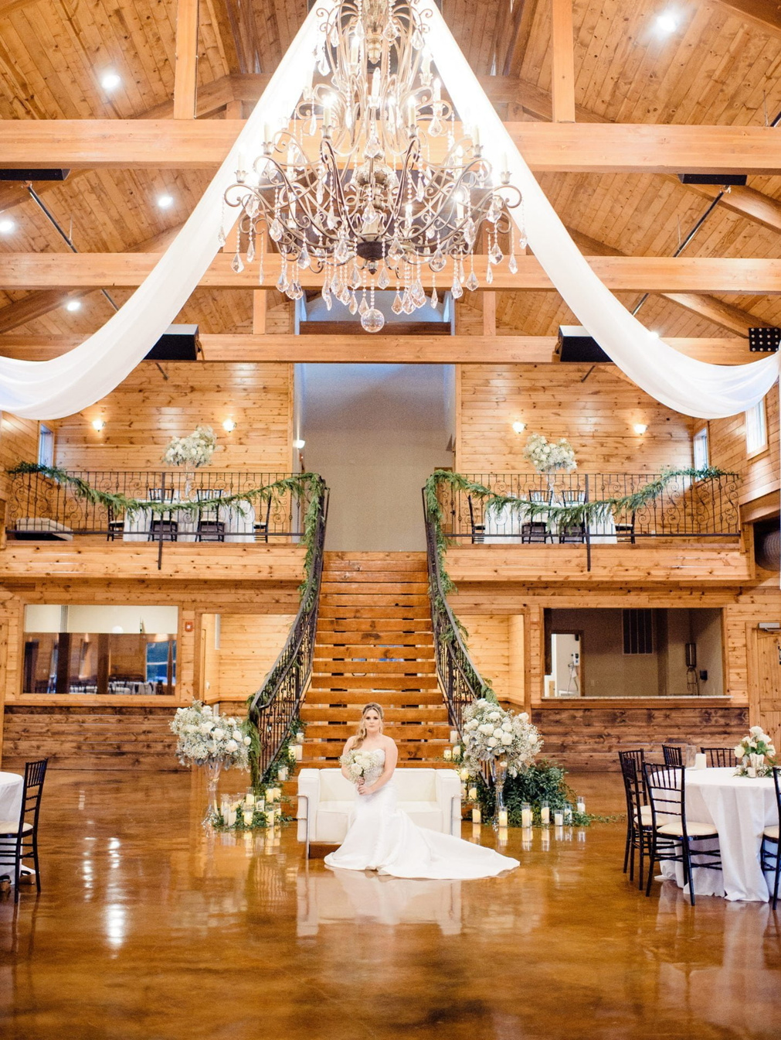
EXAMPLES
Conferences/Events
  Ski Nautique - 3rd year for Rockwall to host annual event
  Texas Parkes & Wildlife Annual Conference- Visit Rockwall bid to host this event for 2024
  Regional Trainings & Board Meetings - Visit Rockwall is here to help bring these meetings to Rockwall
Leisure
  Family Reunions
  Weddings
  Sporting Events

Slide 9
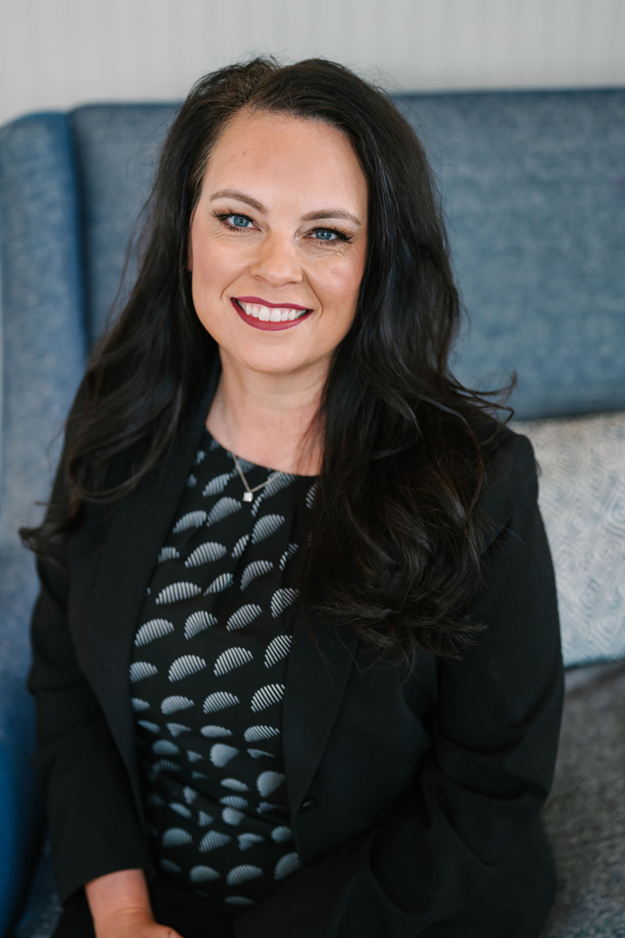
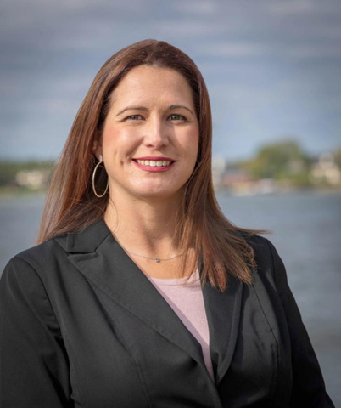
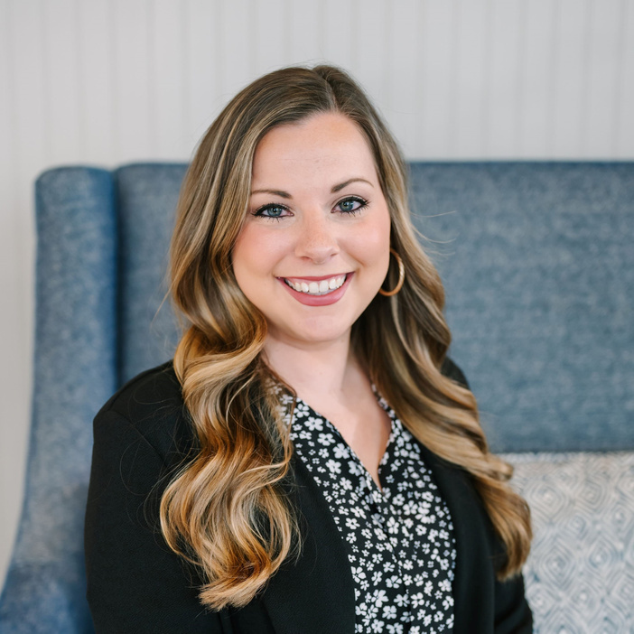
President/CEO
Darby Burkey, IOM
Director of Tourism
Jodi Willard
THE VISIT ROCKWALL TEAM
Tourism & Programs Manager
Kelsey Curbo

Slide 10

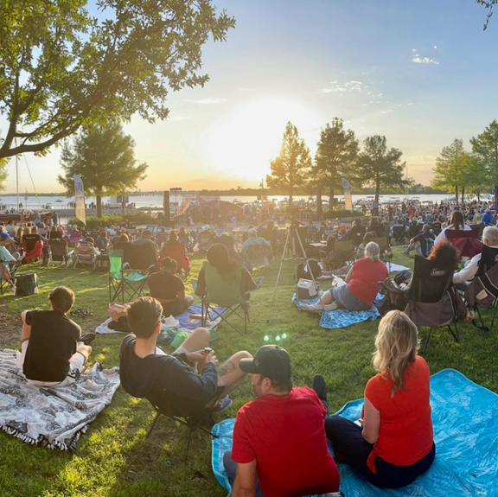


MARKETING INITIATIVES
Leisure Tourists Meeting Planners Groups/Associations

Slide 11
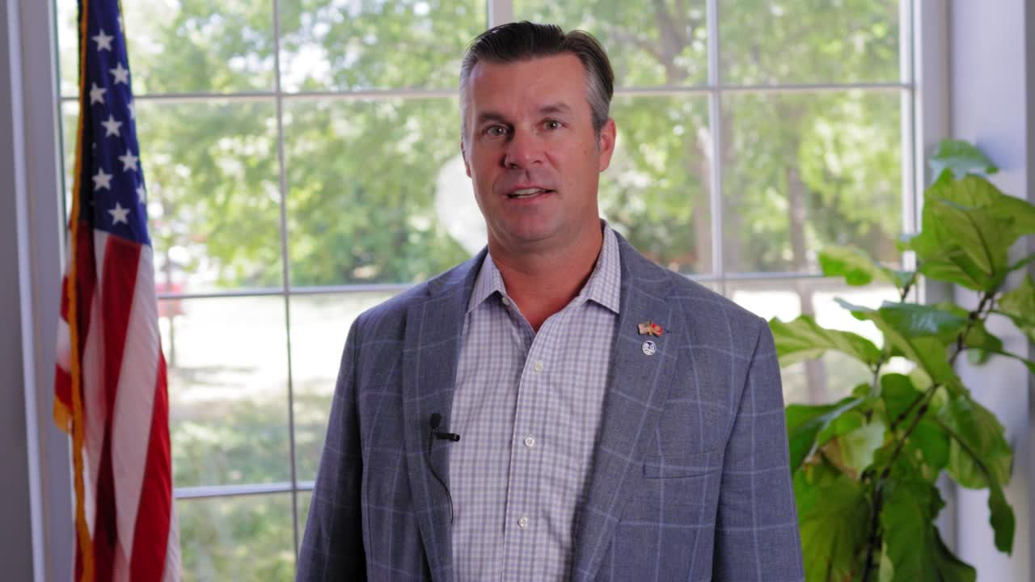
MEETINGS VIDEO

Slide 12

PROMOTION OF HOTELS AND LOCAL BUSINESSES
Visit Rockwall serves as the hub for hotels, attractions and local businesses
  Social Media Marketing Strategy
  Organizing group receptions at local venues
  Promoting events on a state wide level
  Highlighting area hotels

Slide 13
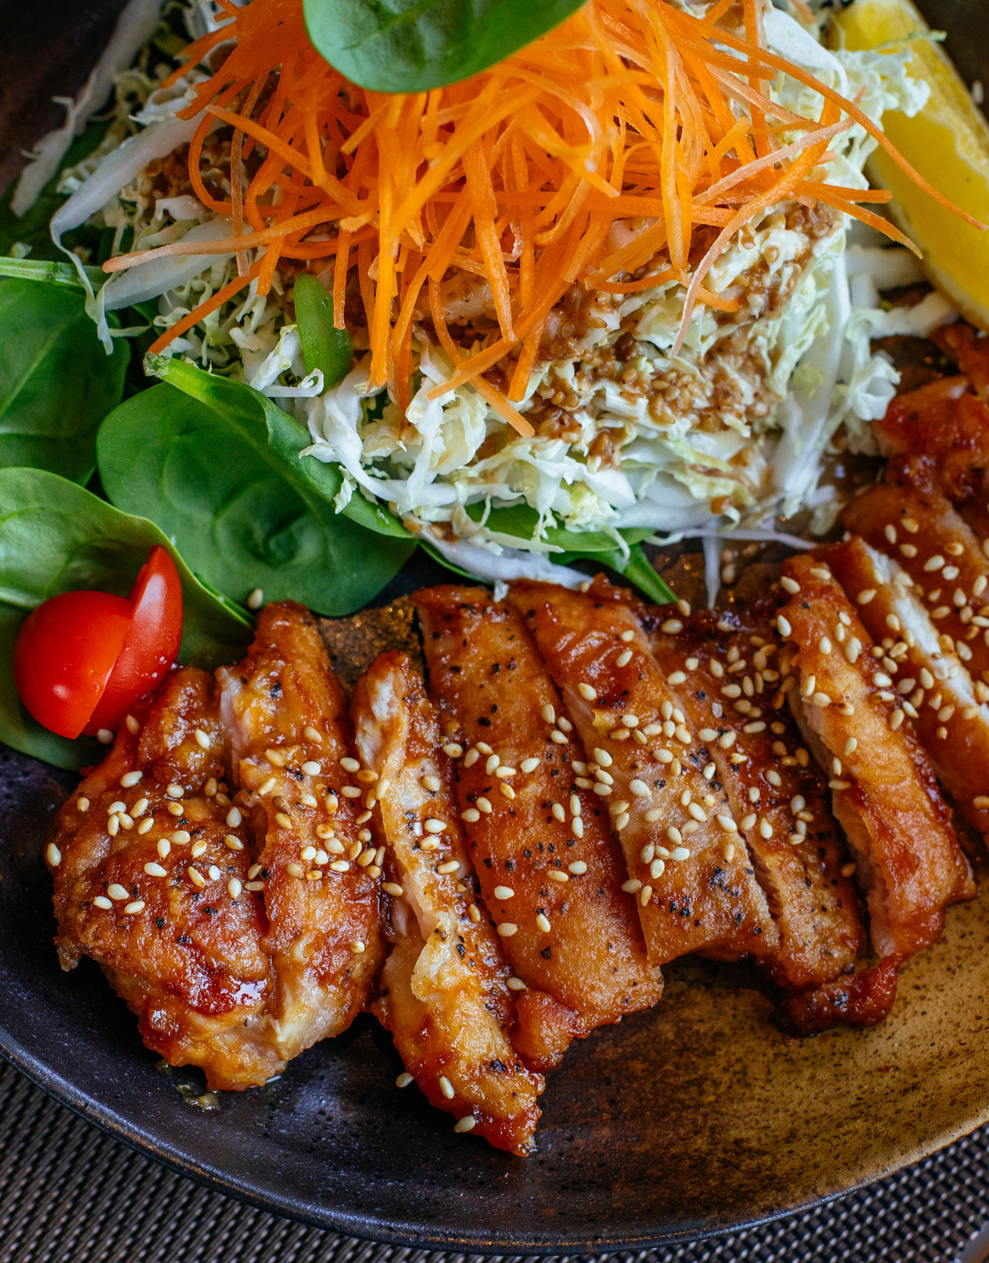
MARKETING STRATEGY
Visit Rockwall has determined the
best marketing opportunities
  Lake Ray Hubbard
  Culinary - local chef driven and nationally recognized restaurants
  History & Patriotism
  Music & Nightlife - Free Live Music Capital of North Texas
  The Great Outdoors

Slide 14

FUTURE MARKETING PLANS
Print
  Visit Rockwall Brochures
  Texas Meetings & Events
  Texas Highways Texas State
  Travel Guide
  DFW Child
  D Magazine
  Rockwall Community Guide
Digital
  Agenda
  Tour Texas
  Social Media Ads
  Texas Monthly
  Texas Forest Trails Region
TV
  YOLO TX

Slide 15

ECONOMIC IMPACT
Total Economic Impact from one Marketing Tool - Tour Texas
$260,458
Brochures
Leads
Pageviews
Over 2,000 mailed to potential visitors & residents
Over 780 leads from marketing efforts
Over 60,000 website page views

Slide 16
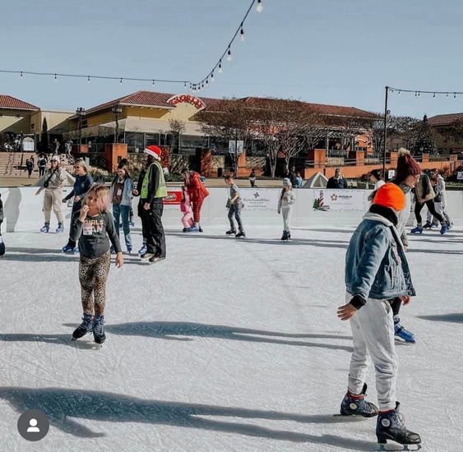
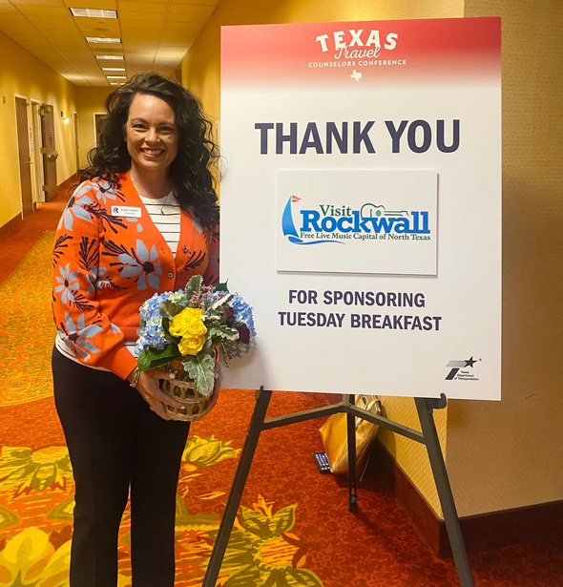
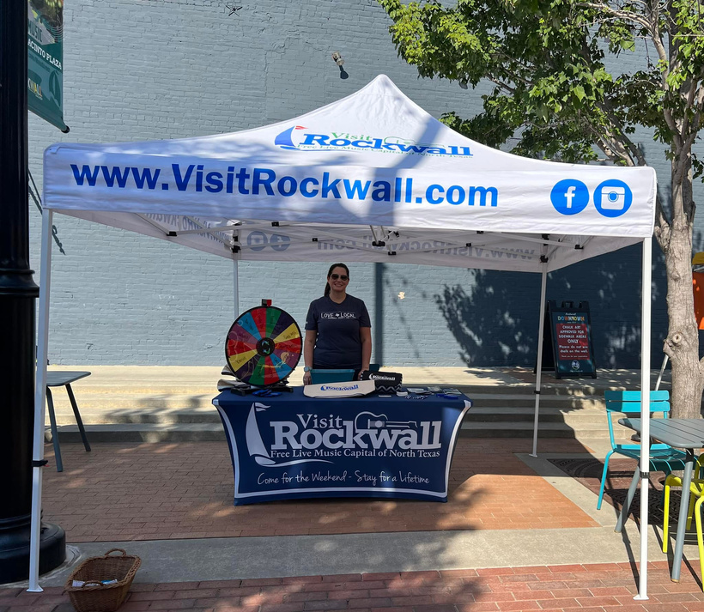
2022 - 2023 HIGHLIGHTS
Introduced Skate the Lake to Rockwall
Partnered with Mesquite CVB to host Travel Expo
Attended Local Events
Servicing
Hosted booth at Rockwall Triathlon
Hosted booth at the Downtown Rockwall Service Anniversary
Attended Visit Rockwall Day at the State Fair
Created & Delivered welcome bags for conferences

Slide 17






INDUSTRY PARTNERS

Slide 18

NEW LOGO

Slide 19
2024 OBJECTIVES & GOALS
OBJECTIVESs
  Work closely with hotels, meeting planners and groups to attract events
  Continue partnerships with hoteliers and local attractions
  Build Relationships
  Marketing program includes
    Conventions
    Sports
    Tourism sales
    Convention Servicing
    Visitor Services
    Advertising
    Public Relations
    Publicity
    Distribution of Information
Goals
Short Term:
  Increase photo & video library
  Reach our projected social media growth
  Leave a positive impression on visitors so they want to return
  Facilitate site visits to Rockwall for the purpose of engaging meeting planners and cultivating local business relations
Long Term:
  Increase hotel nights
  Increase brand awareness of Visit Rockwall
  Proactively secure future conferences and sports events years un advance to strengthen Rockwall’s success & ensure a sustained stream of business

Slide 20
ROCKWALL VISITOR CENTER
Visitor Center has information for:
  New residents relocating
  New businesses relocating
  Visitors in town
  New businesses
Our team is available:
  Answer questions about Rockwall
  Promote Rockwall as a safe community
  Highlight Rockwall’s A+ rated school district
  To help showcase Rockwall as the Unique Upscale Lakeside Community

Slide 21
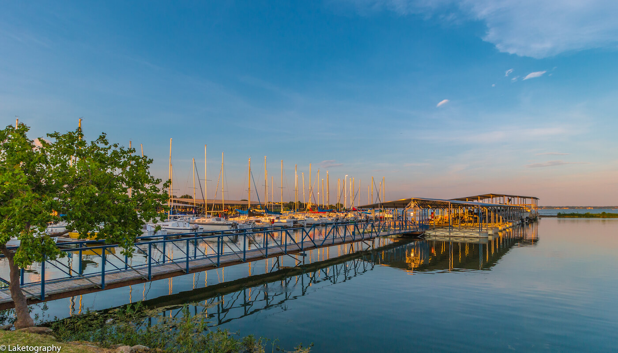
COME FOR A WEEKEND...STAY FOR A LIFETIME!

Slide 22




THANK YOU
VISITORS CENTER
697 East I-30, Rockwall, TX 75087
972.771.5377
jodi@visitrockwall.com
We look forward to partnering with you
VisitRockwall.com

